Slide 1

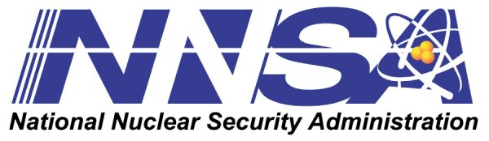




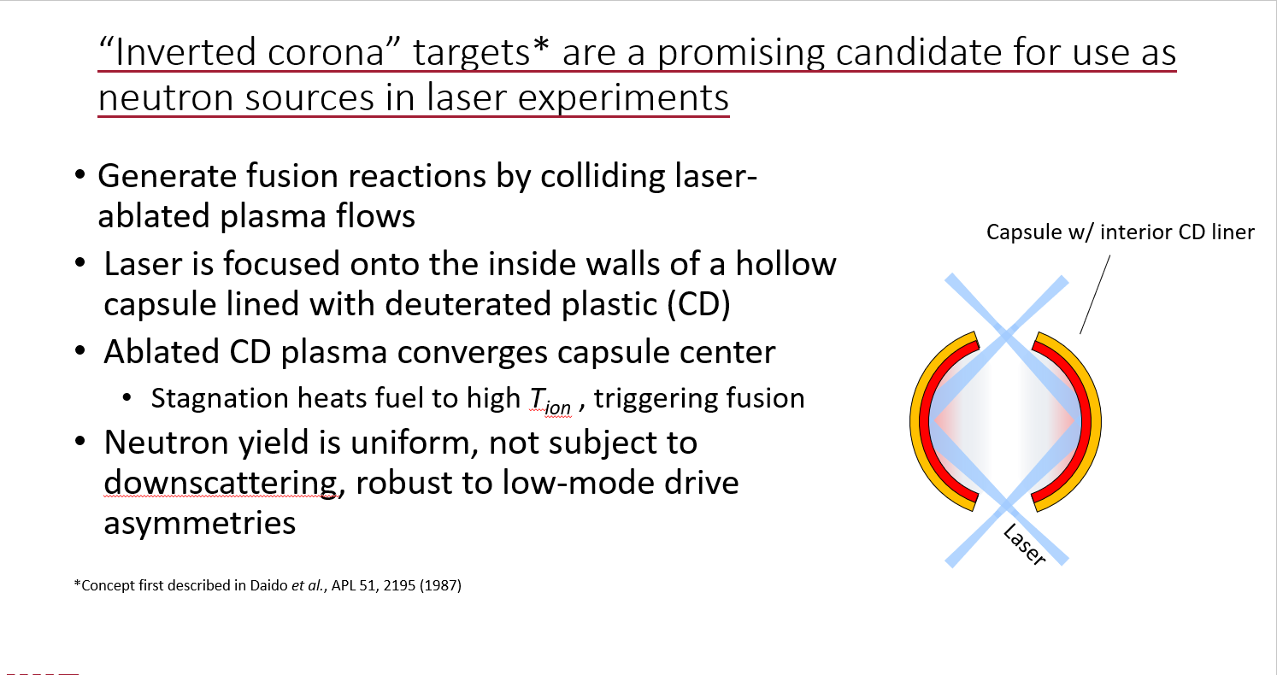
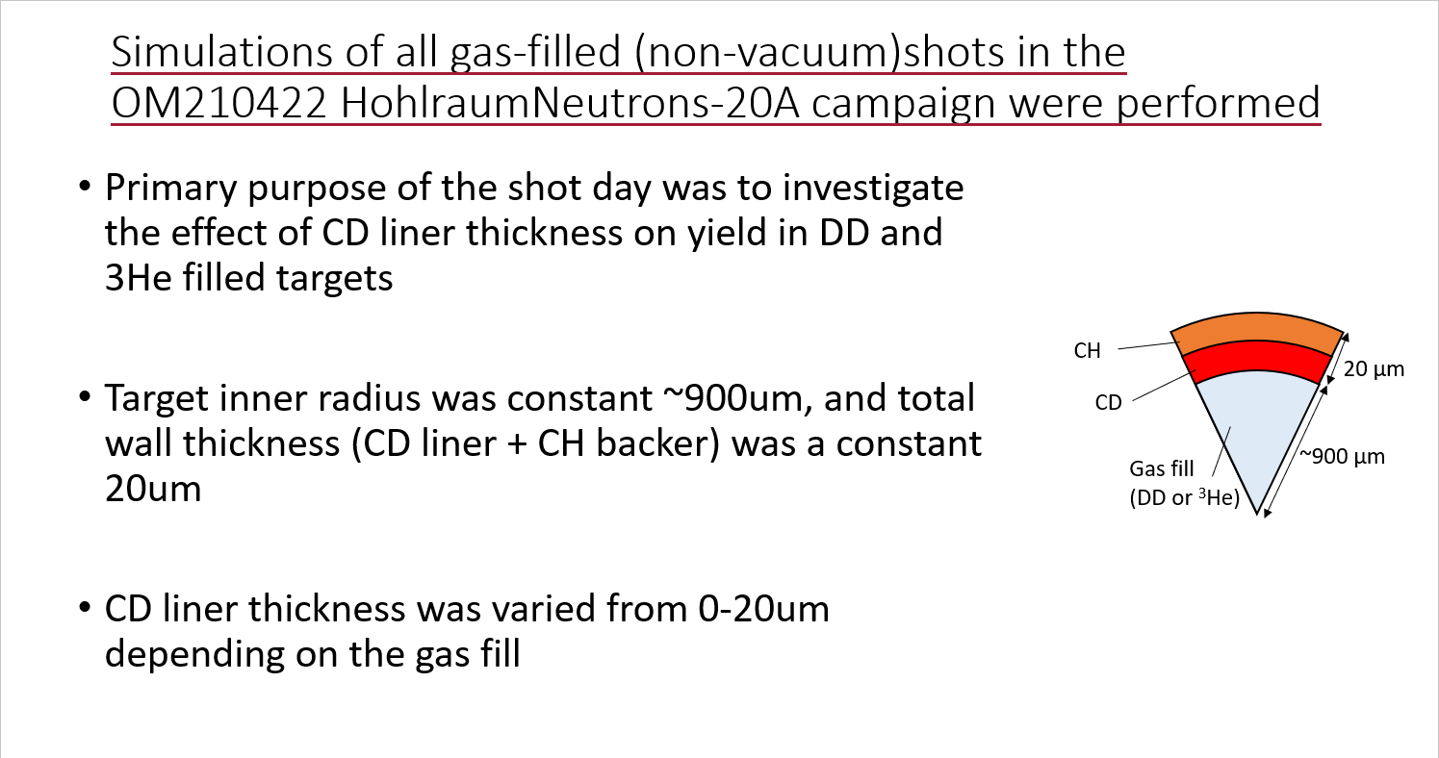
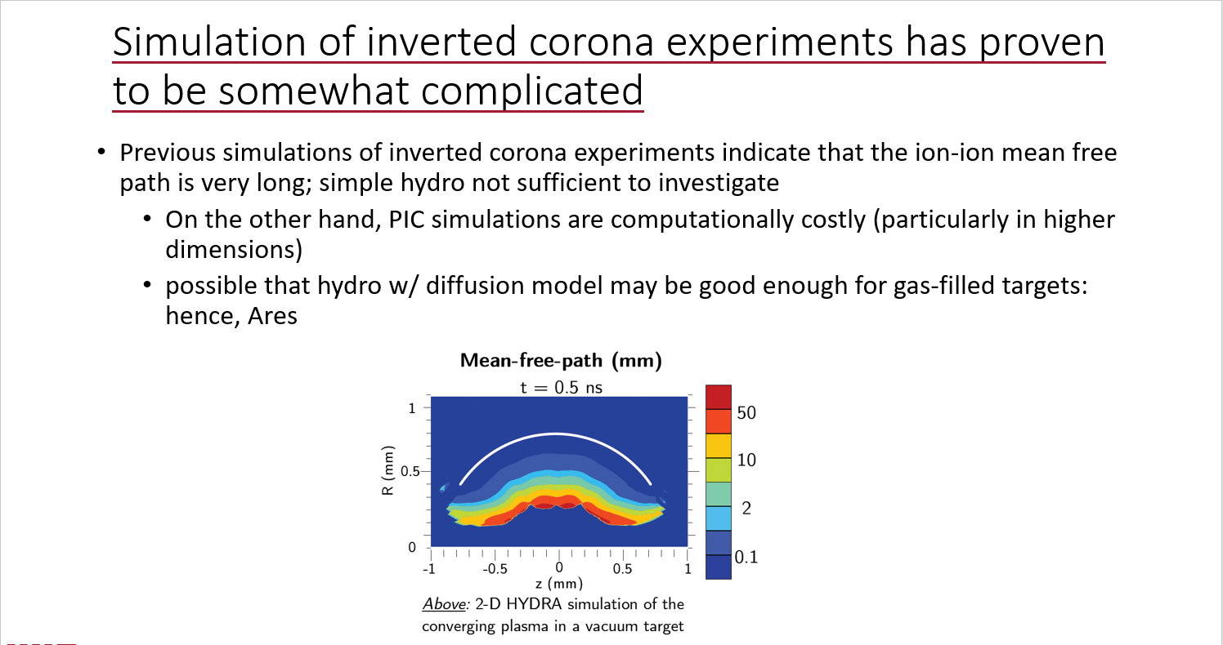
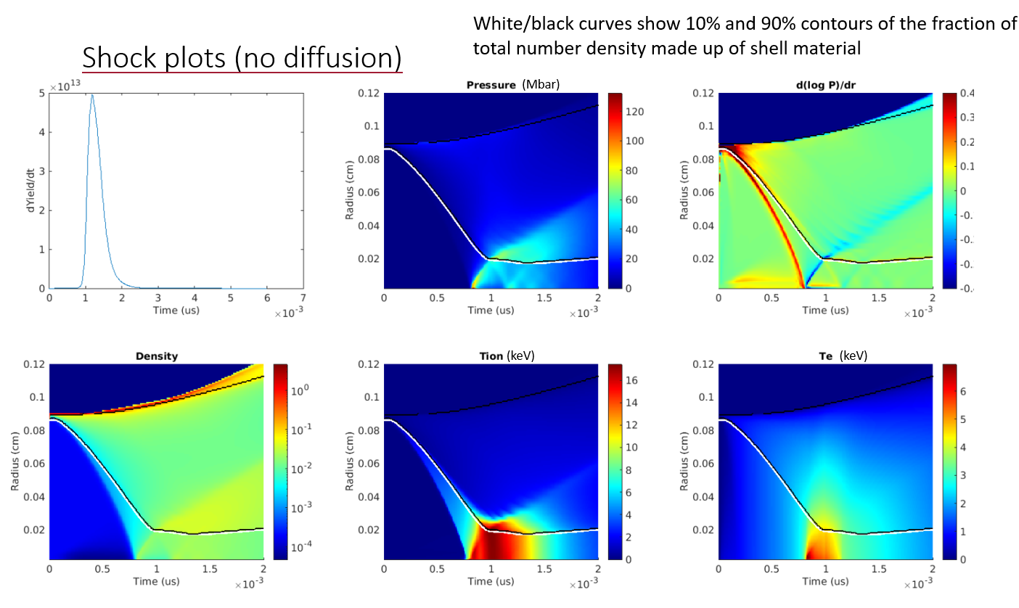
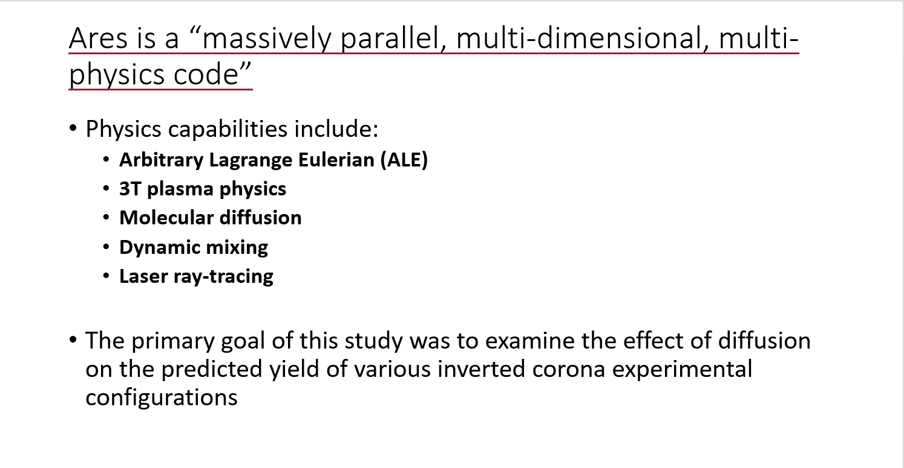
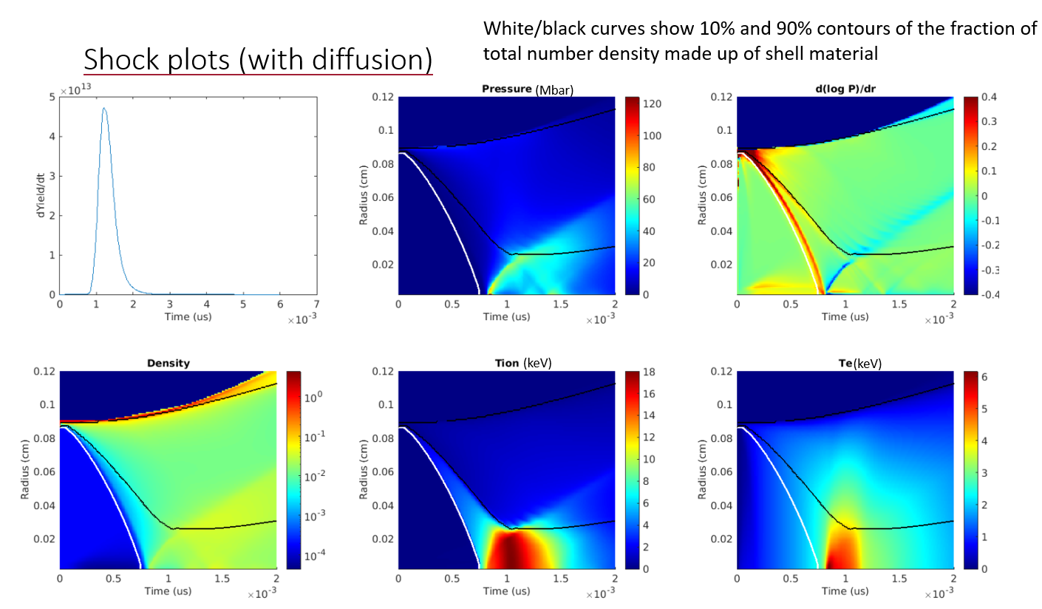
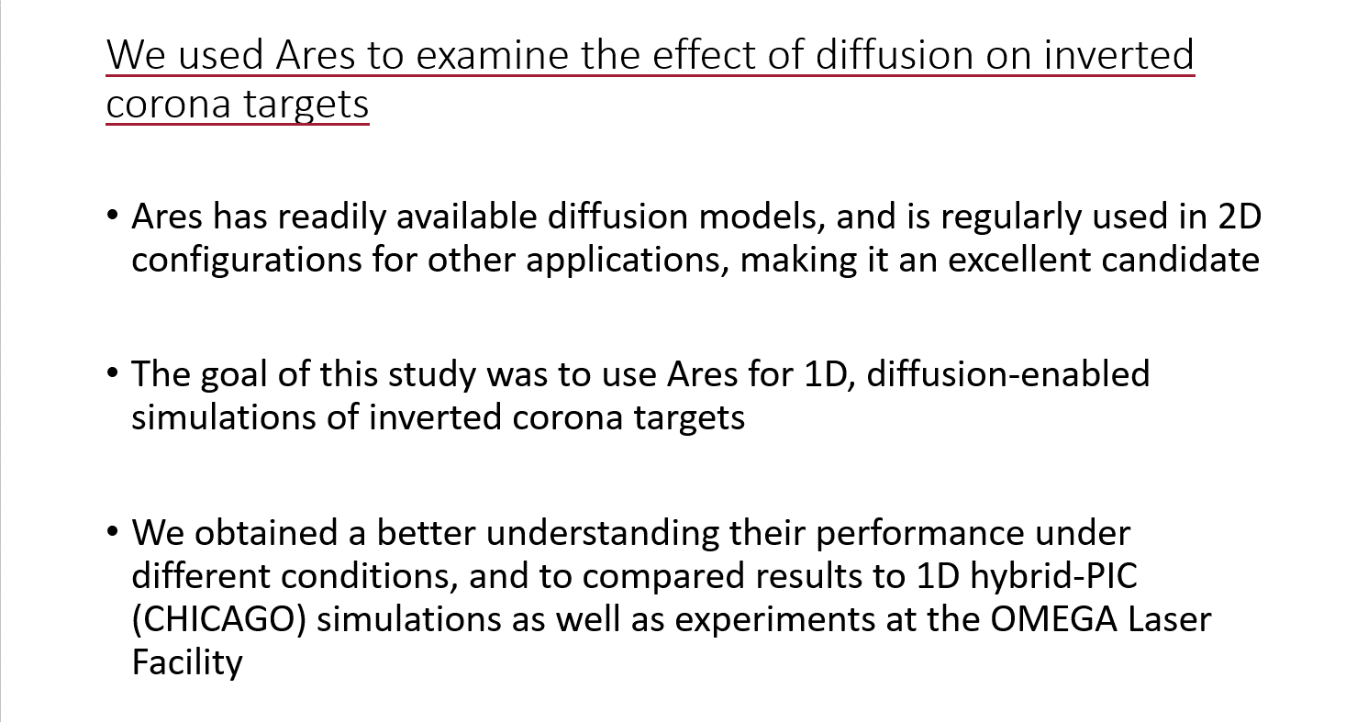
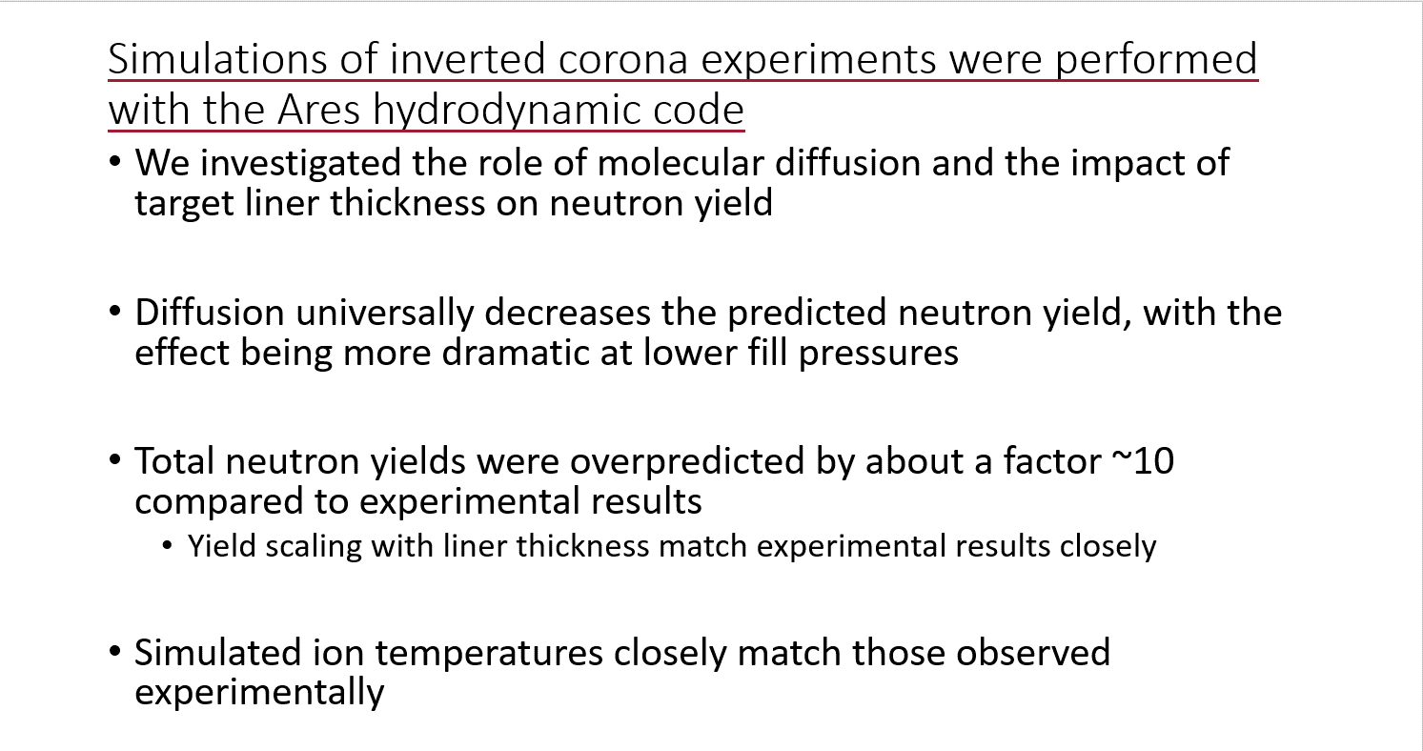


Ares Simulations of Inverted Corona Experiments at OMEGA
Jacob Pearcy*, Nathan Meezan#, Matthias Hohenberger#, Will Riedel^, Neel Kabadi*, Patrick Adrian*
* Massachusetts Institute of Technology Plasma Science and Fusion Center
# Lawrence Livermore National Laboratory
^ Stanford University
ARES simulations of inverted corona experiments accurately predict yield scaling and ion temperatures
Shock plots (no diffusion)
Capsule with
interior CD liner
CH
20 µm total, varying breakdown
CD
~900 µm
Gas fill
(DD or ³He)
Laser
Neutron Yields
Burn-averaged Ion Temperatures
Shock plots (with diffusion)
³He fill (WRF)
DD fill (experimental)$×10$
³He fill (simulated)
DD fill (simulated)
DD fill (simulated)
DD fill (NTOF)
³He fill (NTOF)
³He fill (experimental) $×10$
³He fill (simulated)
MIT PhD students work on NIF diagnostics (PTOF¹, WRFs^{2,} SRFs³, DT secondaries⁴) and fundamental physics (S-factor measurements⁵, simulation of inverted coronae)
¹ poster by Ben Reichelt
² poster by Justin Kunimune
³ poster by Tim Johnson
⁴ poster by Patrick Adrian
⁵ poster by Neel Kabadi
(B640112)

