Slide 1
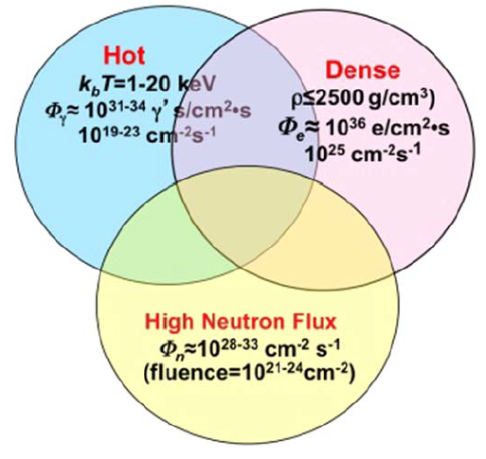
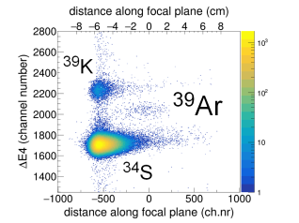
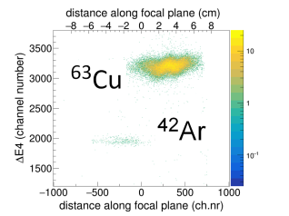
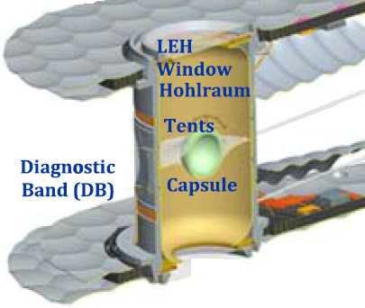
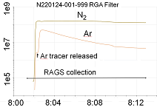
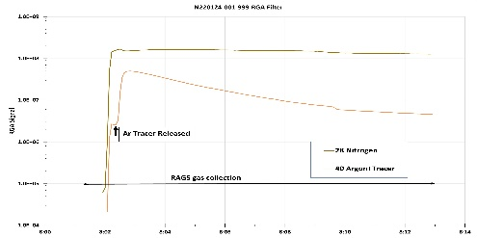
R.N. Sahoo¹, M. Paul¹, C. Velsko², A. Zylstra², M. Tessler³, M. L. Avila⁴, C. Dickerson⁴, H. Jayatissa⁴, J. McLain⁴, R.C. Pardo⁴, K. E. Rehm⁴, R. Scott⁴, I. Toltsukhin⁴, R. Vondrasek⁴, T. Bailey⁵, L. Callahan⁵, A. Clark⁵, Y. Kashiv⁵, A. Nelson⁵, P. Collon⁵, U. Köster⁶, K. Zuber⁷, R. Schwengner⁸
¹Hebrew U. of Jerusalem ²Lawrence Livermore National Laboratory ³Soreq Nuclear Research Center ⁴Argonne National Laboratory ⁵U. of Notre Dame
⁶Institut Laue-Langevin, Grenoble ⁷Technical University Dresden, Dresden ⁸Helmholtz-Zentrum Dresden-Rossendorf, Dresden
Thermodynamical conditions of plasma density, temperature, pressure and the neutron density in a laser-induced implosion of a DT-filled capsule at NIF are the closest laboratory analog to stellar conditions
Experimental method:
Noble-gas accelerator mass spectrometry
(NOGAMS) of Ar sample collected from NIF chamber after the shot.
NOGAMS at Argonne National Laboratory: production of highly-charged Ar⁸⁺ ions, acce-leration to 6 MeV/u, identification in a gas-filled magnetic spectrograph.
Calibration experiments were performed: ⁴⁰Ar(n,2n)³⁹Ar with 14 MeV neutrons ⁴⁰Ar(2n_{th,}γ)⁴²Ar with reactor thermal neutrons
A noble-gas accelerator mass spectrometry platform at NIF for nuclear astrophysics: status report
Neutron-induced reactions in a DT high-density plasma at NIF
⁴⁰Ar(n,2n)³⁹Ar(268 y), ⁴⁰Ar(2n,γ)⁴²Ar(33 y)
Ch J Cerjan et al. J. Phys. G: Nucl. Part. Phys. 45 (2018) 033003
RAGS Argon collection tests at NIF
Static vacuum test froze 15 cc STP argon onto 44 Kelvin collector foam. Recovered 98% from 1 gram charcoal in sample bottle.
Dynamic flow tests with 15 cc STP argon released into NIF Target Chamber on a shot. Two tests complete, chemical analysis needed for argon fraction.
Test 1: gas from foam and end tank=148% based on pressure
Test 2: gas from foam only=56% based on pressure
DT+ ⁴⁰Ar
We plan studying neutron-induced reactions:
⁴⁰Ar(n,2n)³⁹Ar(268 y), ⁴⁰Ar(2n,γ)⁴²Ar(33 y)
(n,2n): monitor of fast-neutron flux (2n,γ): monitor of extreme neutron density approaching stellar r process. The chemical inertness of the noble gas Ar allows for reliable collection of reaction products.
⁴⁰
+ tracer
⁴⁰
RGA signal
Argon tracer release on N220124

