Slide 1
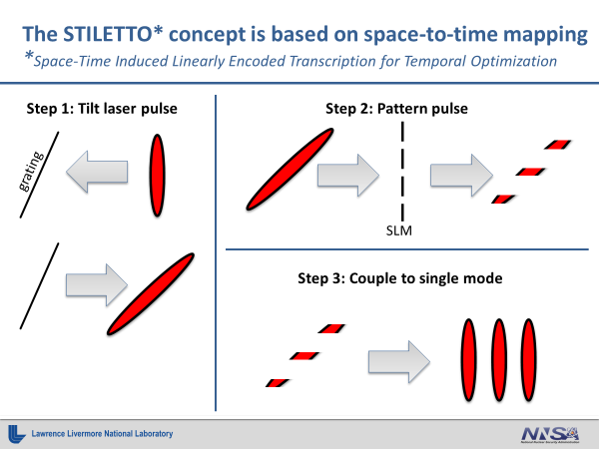
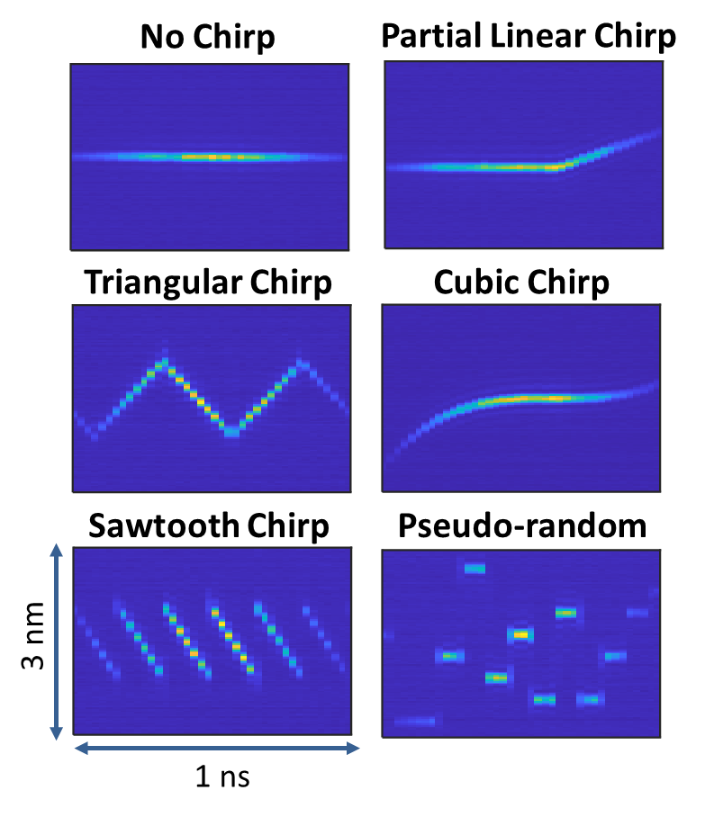
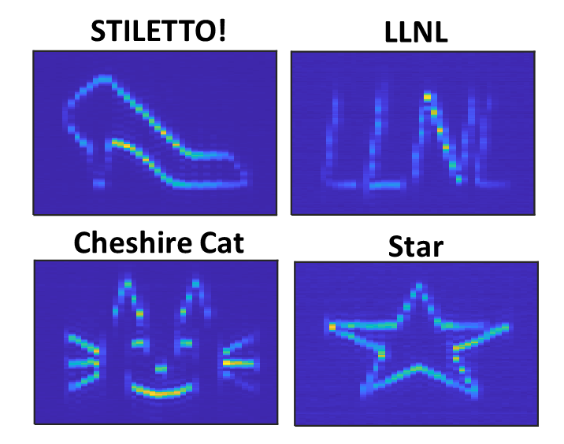
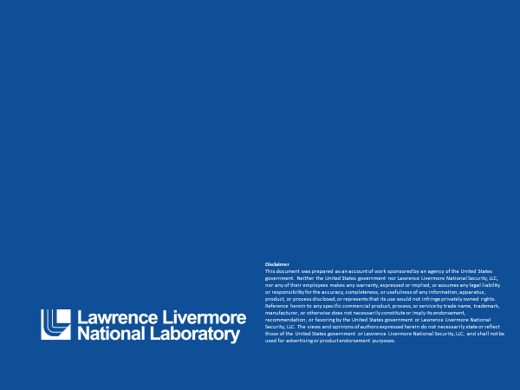
Dynamic Wavelength Encoding with STILETTO: enabling arbitrary, programmable intensity and wavelength vs. time
D. Mittelberger, R. Muir, and J. Heebner
Lawrence Livermore National Laboratory (LLNL)
STILETTO modulates laser intensity and wavelength on a picosecond timescale. Spectrograms show the novel wavelength profiles enabled by this method.
Quick Facts:
Total E-field control*: modulate intensity and wavelength vs. time over 10-1000 ps
Control intensity with picosecond resolution (100’s of independent temporal features)
Create spectrograms (spectrum vs. time) by time gating with intensity modulation
* up to an arbitrary phase
Complex Chirps²
Multiple synced waveforms²
Intensity Modulation¹
References
1) DE Mittelberger, R Muir, D Perlmutter, J Heebner, “Programmable, direct space-to-time picosecond resolution pulse shaper with nanosecond record,” Optics Letters 46 (8), 1832-1835
2) DE Mittelberger, RD Muir, JE Heebner, “Dynamic wavelength control of laser pulse profiles at picosecond to nanosecond timescales,” Optics Express 30 (2), 1875-1884 (2022)
Verified by cross-correlation
Verified by self-gated spectrograms
LLNL-POST-831352

