Slide 1


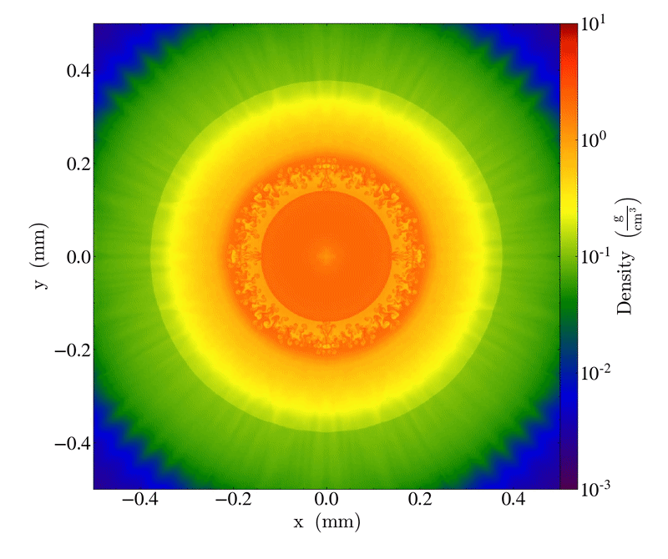
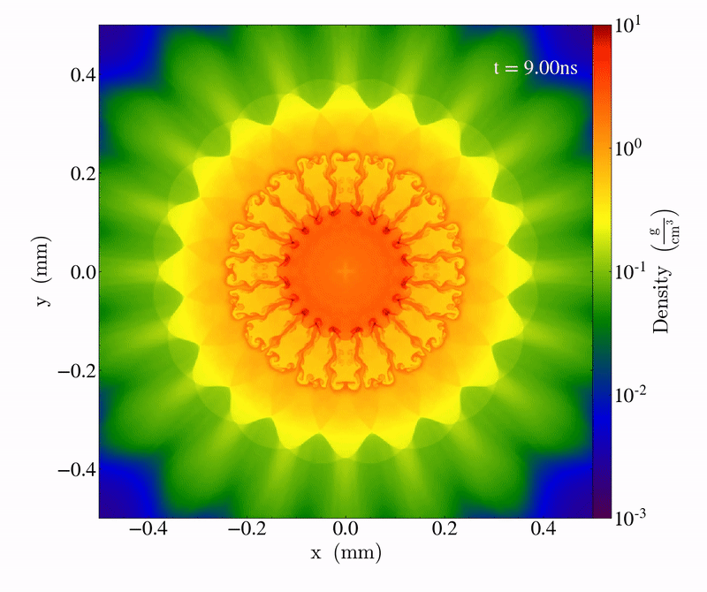
Expanding the Tabulated Equation of State Implementations in the FLASH Code for the SESAME Database
P. Farmakis¹, M. McMullan², A. Reyes¹, J. Laune³, M. B. P. Adams¹, A. Armstrong¹, E. Hansen¹, Y. Lu¹,
D. Michta¹, K. Moczulski¹, D. Lamb⁴, P. Tzeferacos¹
¹University of Rochester, USA; ²The College of New Jersey, USA; ³Cornell University, USA; ⁴University of Chicago, USA
Abstract
We present the enhancement of the tabulated Equation-of-State (TEOS) capabilities of FLASH [1], a high-performance computing, finite-volume radiation magnetohydrodynamics (MHD) code developed by the Flash Center for Computational Science. FLASH has extended physics capabilities [2] that enable the code to treat a broad range of physical processes in astrophysics, laboratory plasma physics, and high energy density physics (HEDP). Here we extend the tabulated EOS implementation of the FLASH code to make use of the SESAME EOS database [1], generated and curated by the Los Alamos National Laboratory. This improvement provides FLASH with high-fidelity data for the materials used in laser-driven and pulsed-power driven experiments. We verify the new capability with benchmark HEDP problems and show how they favorably compare against FLASH’s previous tabulated EOS implementations.
Interpolation strategy within the FLASH framework
The SESAME tables of interest are selected by reading through the material property file to isolate the data associated with specific EOS headers. SESAME provides several TEOS options [4,6]. The framework of the FLASH code requires tables 304 and 305, the ion and electron TEOS entries, respectively. The reader truncates the range in the (T, ρ) space, eliminating data of problematic regions, i.e., negative entries. With the working range defined, FLASH scans the ranges of the two truncated 304 and 305 matrices to determine their relative orientation.
Use of the SESAME database in FLASH simulations
The FLASH code requires ionization information on top of the thermodynamic quantities provided by SESAME. Thus, interpolating the 304 and 305 matrices using the uniform grid, shown in Fig. 2 as table C, allows the generation of an additional table mapping the ionization of the material across the interpolated (T, ρ) range. Calculation of the average ionization of the material follows the formulary description found in [9]. Using the data from the 304 and 305 TEOS for the material ionization state is a good approximation, as we discuss below.
While this is a first step towards a more complicated EOS description based on first-principles (FPEOS), the strategy has proven to be consistent, and is used in simulations. The implementation described so far offers FLASH a native tool to handle SESAME; up until now, FLASH users relied on an external, purpose-built tool, Opacplot2 [8] to convert SESAME into the CONRAD EOS format that FLASH uses by default. A simulation campaign of 2D cylindrical implosions by Y. Lu utilizes SESAME, as illustrated in Fig. 4.
The SESAME tabulated structure: Strengths and Complexities
Traditionally, an equation of state comprises thermodynamic functions to describe the response of the physical properties a particular material might exhibit under a given set of physical conditions. While an equation might be convenient to program, the physics it can represent can be limited due to the assumptions introduced to formulate it. A tabulated EOS can be more expansive, using a model or combinations thereof to describe thermodynamic properties to varying degrees of physical accuracy [6]. In this respect, a TEOS may offer significant advantages over simpler, analytic EOS.
The SESAME database is a TEOS although rather than solely relying on theoretical models, it is physically motivated [3,4]: experimental data check in different regions the consistency of the thermodynamic interpolations. SESAME involves tabulated equilibrium data [7] in logically-cartesian tables [5], using two state functions (e.g., temperature and density) to populate the phase-space with other macroscopic properties like pressure, internal energy, for 150+ materials.
Therefore SESAME, being publicly available, contains the necessary physics for simulating astrophysical and HEDP systems using FLASH. Nevertheless, the database is not fully compatible with the code outright [5]. Data entries may fall into regimes of negative pressures, for which FLASH will predict non-physical wave speeds. For this reason, FLASH typically initializes a given material at a higher temperature to avoid pathologies [7] (see Fig. 1).
Figure 2. Illustration of table orientation and the creation of the interpolating grid.
By determining their relative orientation, FLASH can pinpoint the overlapping region in the (T, ρ) space of the concatenated 304 and 305 tables (represented by A, and B, Fig. 2). By implication, this allows the code to establish a common temperature and density envelope for the simulation. The new bounds direct the creation of a new, very fine grid (matrix C, Fig. 2), upon which the physical values of the 304 and 305 EOS tables are interpolated; its high resolution ensures that the derived table accurately captures the profiles of constitutive quantities. Bilinear interpolation is used to populate matrix C (see Fig. 3 below).
Figure 4. Density colormaps of 2D cylindrical implosions in FLASH using SESAME.
The development of the native SESAME reader in FLASH folds SESAME TEOS into the FLASH code development efforts, provides us with opportunities for the further improvements, and enables FLASH users to take advantage of the established EOS database developed by LANL.
Future Work
Expansion of the reader to more material properties tables included in the SESAME database.
Incorporate the new native reader to the publicly available release of FLASH.
Advance the current work with higher-order interpolation schemes.
Expand the reader for other TEOS databases sharing SESAME’s data format, f.e., an FPEOS package.
References
[1] B. Fryxell et. al., “FLASH: An adaptive mesh hydrodynamics code for modeling astrophysical thermonuclear flashes,” The Astrophysical Journal Supplement Series 131(1), p. 273, 2000.
[2] P. Tzeferacos et. al., “FLASH MHD simulations of experiments that study shock-generated magnetic fields,” High Energy Density Physics 17A, pp[24-31], 2015, doi: 10.1016/j.hedp.2014.11.003.
[3] LANL, “SESAME: The Los Alamos National Laboratory Equation of State Database,” LA-UR-92-407, 1979.
[4] S. Crockett, “SESAME EOS Introduction,” T-Division T-1, Los Alamos National Laboratory 1999.
[5] G. A. Young, “Sesame ASCII 2 File Format,” LA-UR-21-23834, LANL 2021, doi: 10.2172/1778755.
[6] J. McHardy, “An introduction to the theory & use of SESAME equations of state” LA-14503, doi: 10.2172/1487368.
[7] D. A. Pimentel and D. G. Sheppard, “Pre-inverted SESAME data table construction enhancements to correct unexpected inverse interpolation pathologies in EOSPAC 6,” 2018, doi: 10.2172/1419738.
[8] J. T. Laune et. al. “Opacplot2: Enabling tabulated EoS and opacity compatibility for HEDLP simulations with the FLASH code,” APS Division of Plasma Physics Meeting 2017, Bibcode: 2017APS..DPPJ11045L
[9] S. Atzeni and J. Meyer-ter-Vehn, “The physics of inertial fusion: Beam plasma interaction, hydrodynamics, hot dense matter,” Oxford: Clarendon Press 2004, ISBN-13: 9780198562641.
Figure 1. Example for material 3720 (Aluminum) for the ion pressure. The region
containing negative pressures is highlighted on the right, and the current
treatment of negative entries is shown on the plot on the right side.
Figure 3. Schematic illustration of interpolations on a coarse and a fine grid.
The Flash Center acknowledges support by the U.S. DOE ARPA-E under Award DE-AR0001272, the NSF under Award PHY-2033925, and the U.S. DOE NNSA under Award DE-NA0003842, and Subcontracts 536203 and 630138 with LANL and B632670 with LLNL. This material is based upon work supported by the U.S. DOE NNSA under Award Number DE-NA0003856 through the Horton Fellowship Program at the Laboratory for Laser Energetics.

