Slide 1



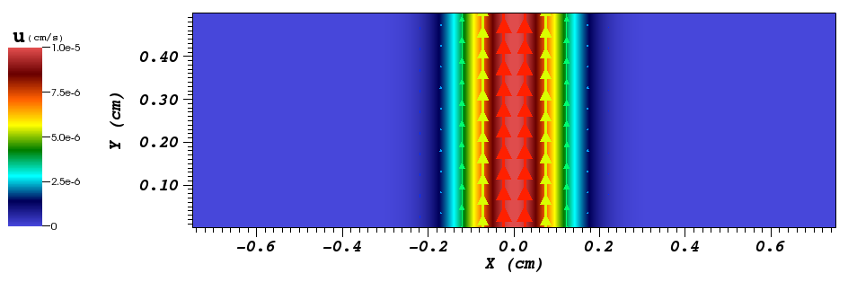
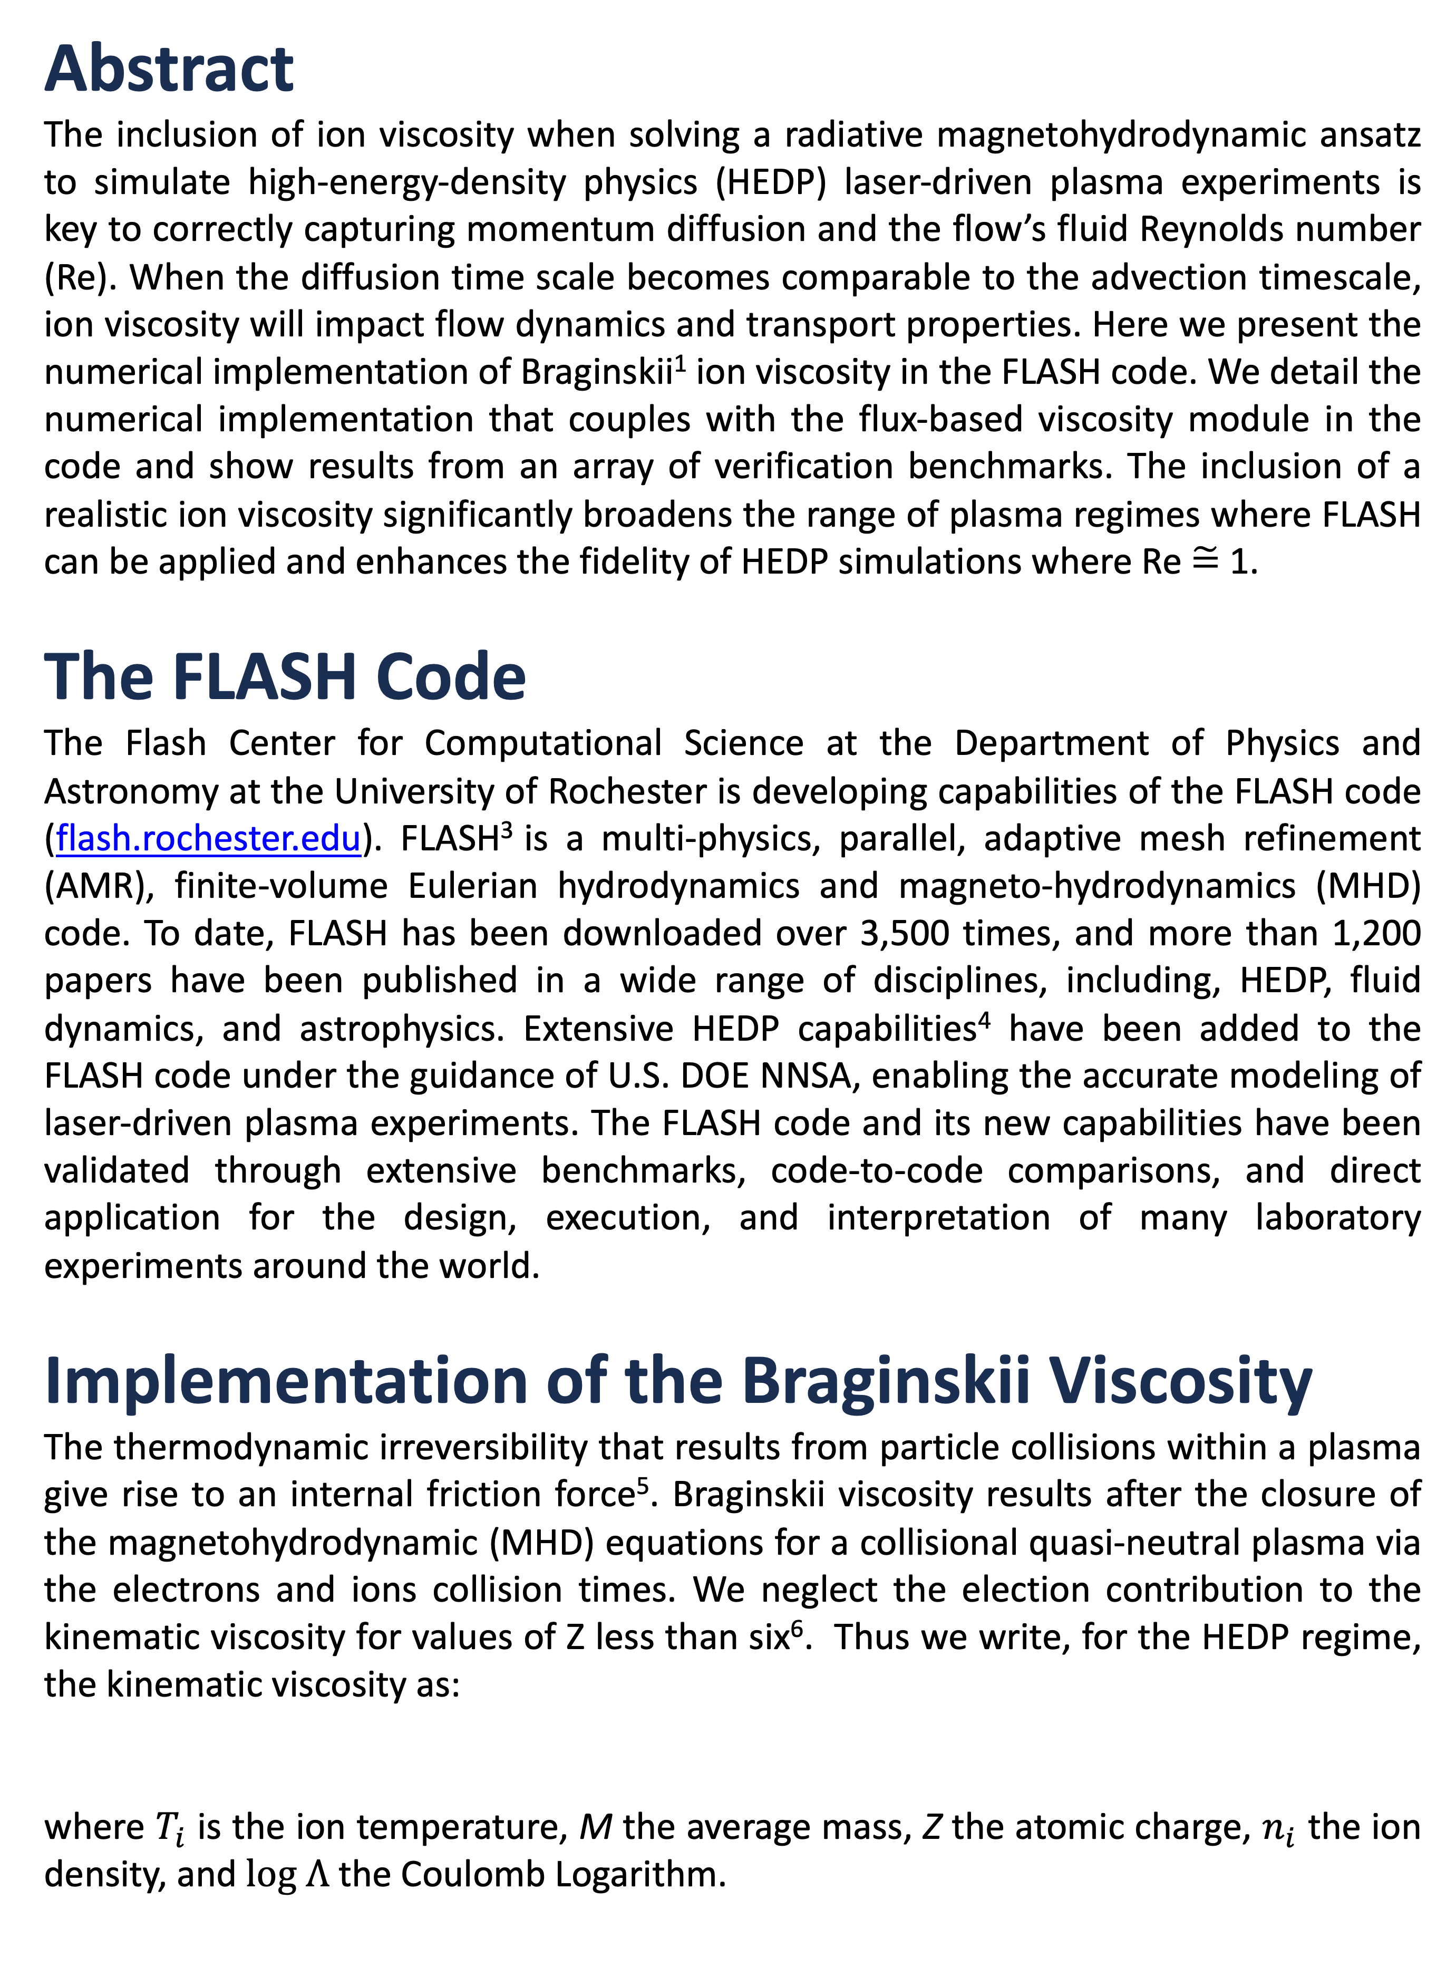
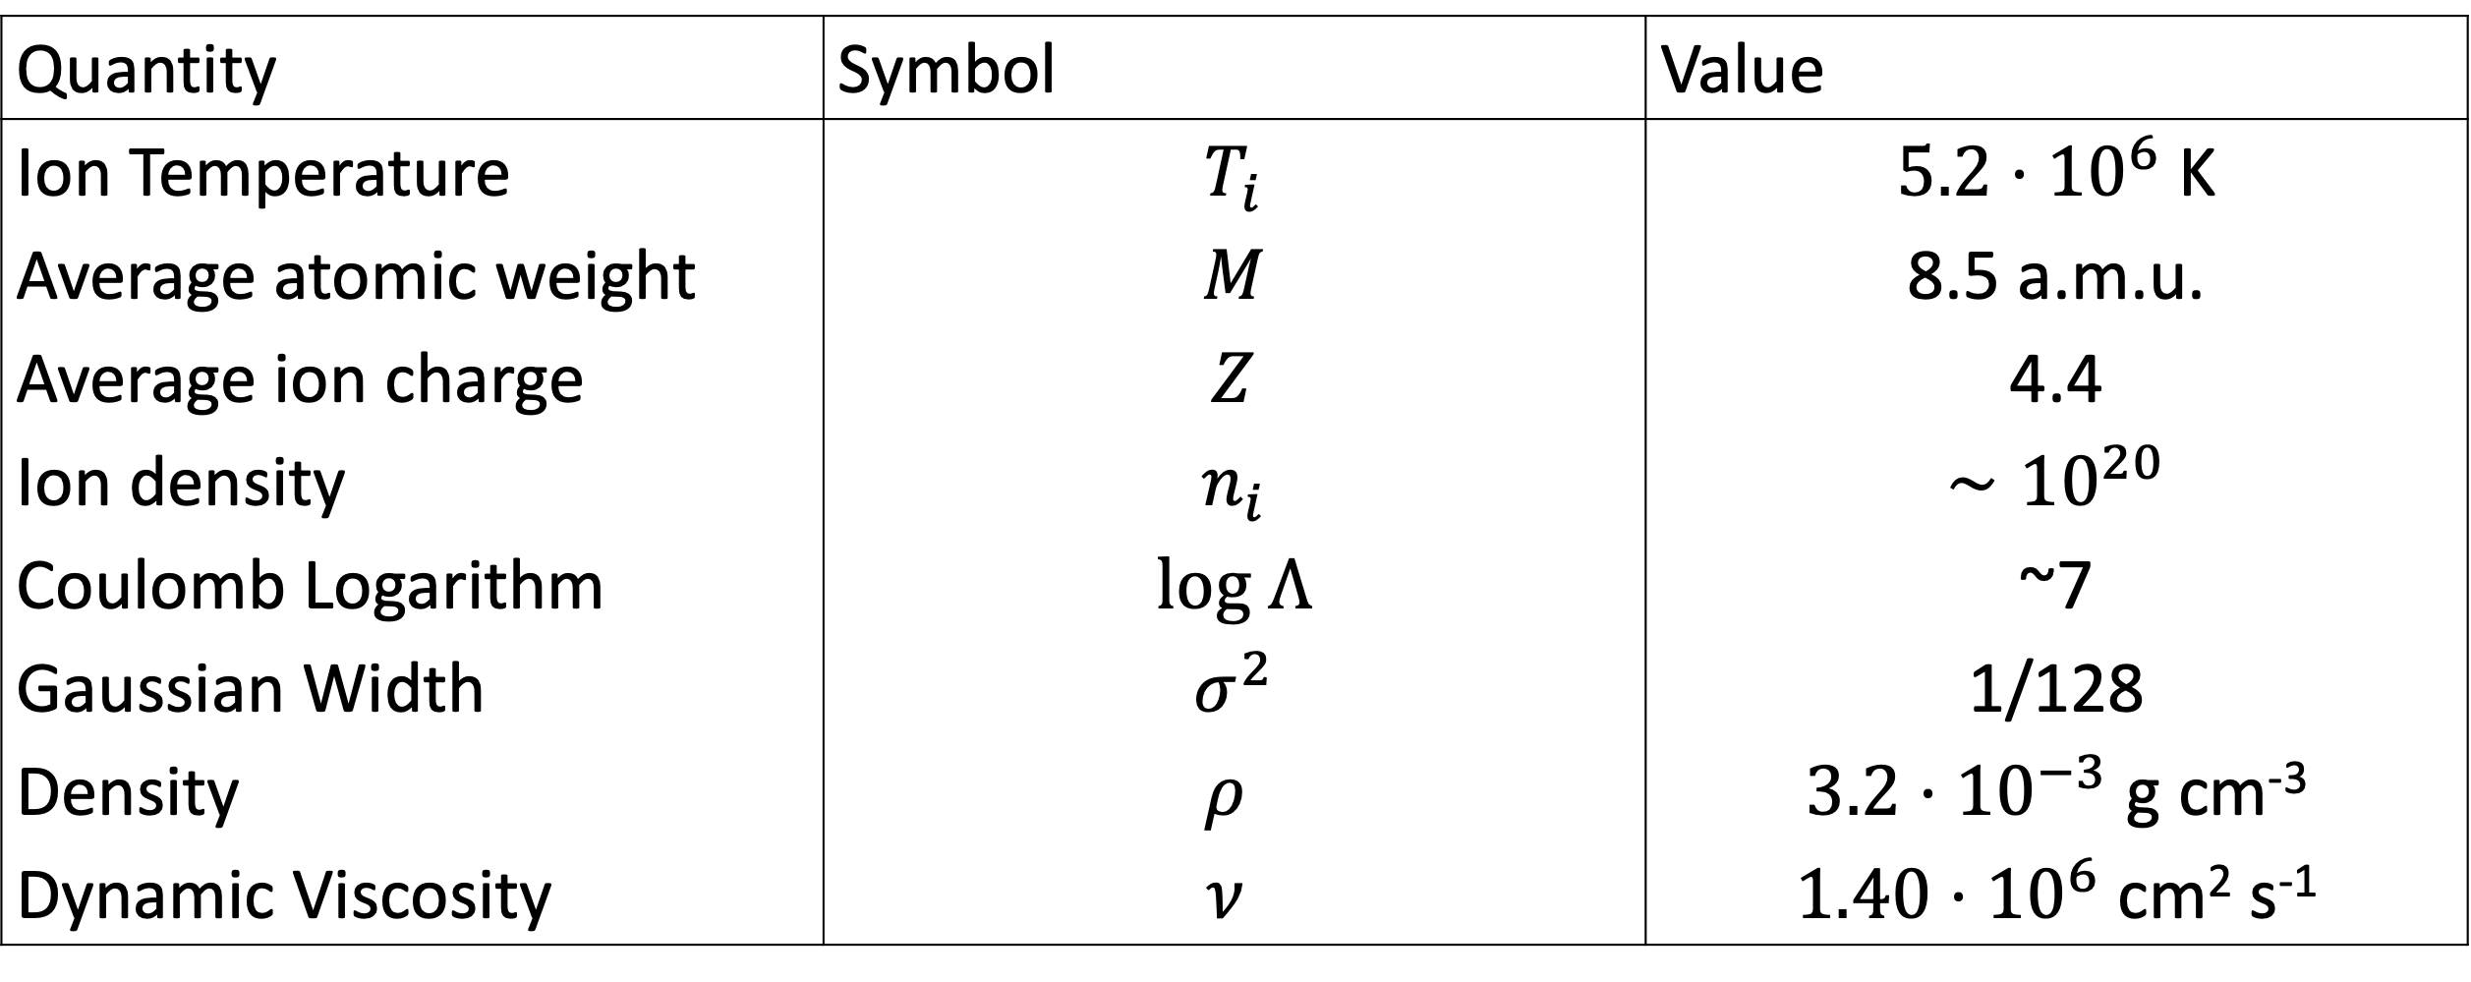

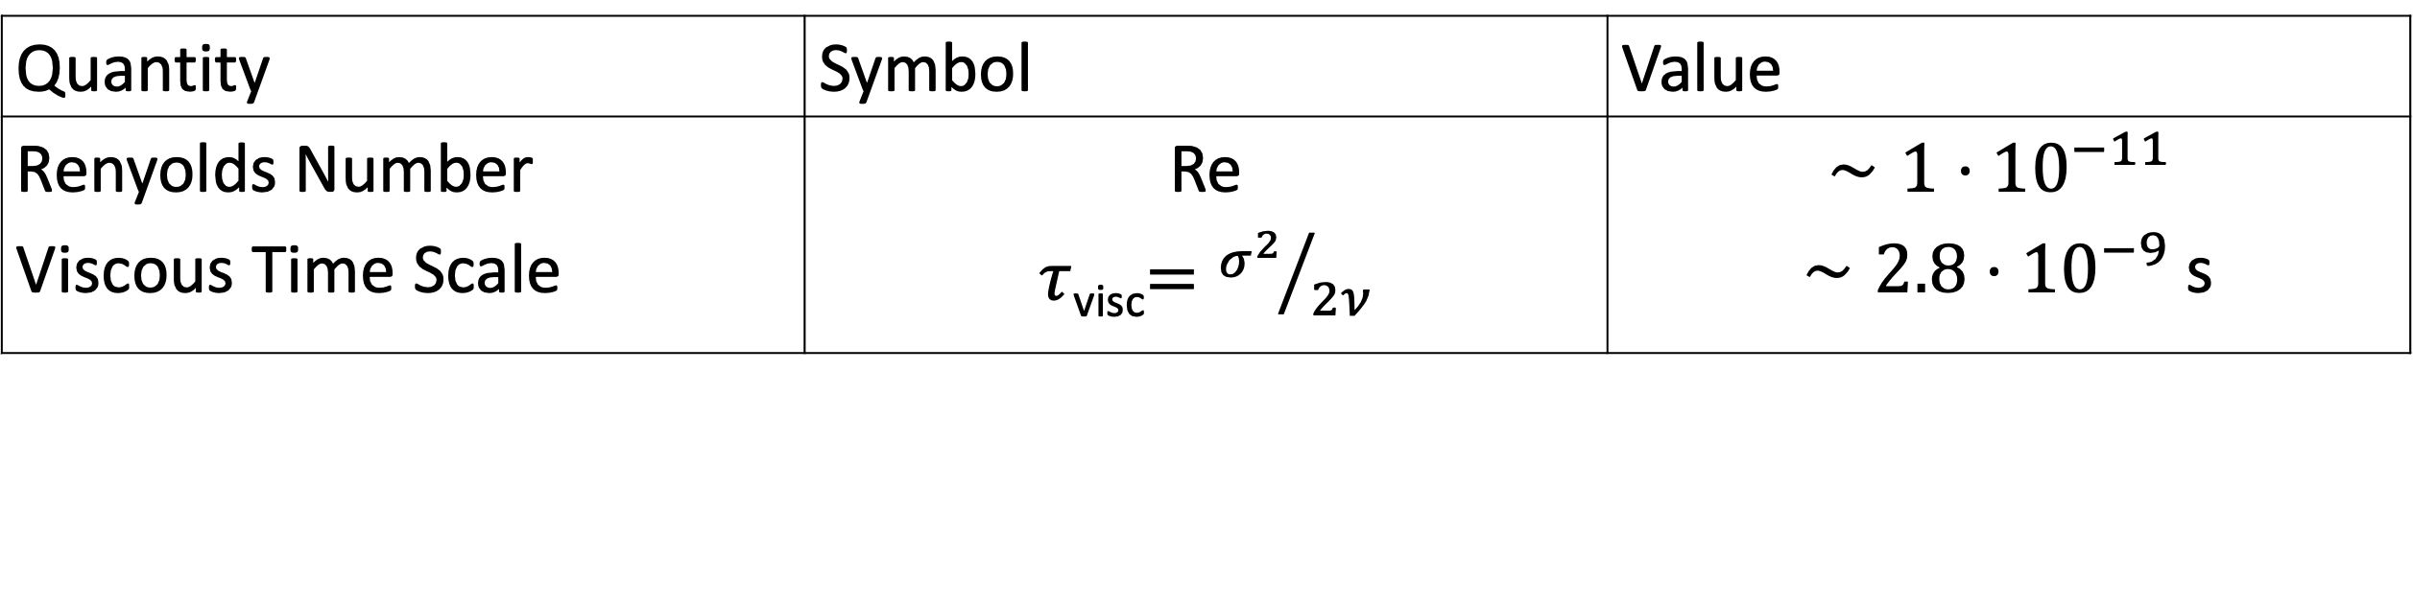

Implementation and Verification of Braginskii Viscosity in the FLASH Code
A. Armstrong¹, A. Reyes¹, M.B.P. Adams¹, P. Farmakis¹, E.C. Hansen¹, Y. Lu¹, D. Michta¹, K. Moczulski¹, D. Q. Lamb³, and P. Tzeferacos^{1,2}
¹Department of Physics and Astronomy, University of Rochester, USA ; ²Laboratory for Laser Energetics, University of Rochester, USA; Department of Astronomy and Astrophysics, University of Chicago, USA³;
Abstract
The inclusion of ion viscosity when solving a radiative magnetohydrodynamic ansatz to simulate high-energy-density physics (HEDP) laser-driven plasma experiments is key to correctly capturing momentum diffusion and the flow’s fluid Reynolds number (Re). When the diffusion time scale becomes comparable to the advection timescale, ion viscosity will impact flow dynamics and transport properties. Here we present the numerical implementation of Braginskii¹ ion viscosity in the FLASH code. We detail the numerical implementation that couples with the flux-based viscosity module in the code and show results from an array of verification benchmarks. The inclusion of a realistic ion viscosity significantly broadens the range of plasma regimes where FLASH can be applied and enhances the fidelity of HEDP simulations where Re $\tilde{=}$ 1.
The FLASH Code
The Flash Center for Computational Science at the Department of Physics and Astronomy at the University of Rochester is developing capabilities of the FLASH code (flash.rochester.edu). FLASH³ is a multi-physics, parallel, adaptive mesh refinement (AMR), finite-volume Eulerian hydrodynamics and magneto-hydrodynamics (MHD) code. To date, FLASH has been downloaded over 3,500 times, and more than 1,200 papers have been published in a wide range of disciplines, including, HEDP, fluid dynamics, and astrophysics. Extensive HEDP capabilities⁴ have been added to the FLASH code under the guidance of U.S. DOE NNSA, enabling the accurate modeling of laser-driven plasma experiments. The FLASH code and its new capabilities have been validated through extensive benchmarks, code-to-code comparisons, and direct application for the design, execution, and interpretation of many laboratory experiments around the world.
Implementation of the Braginskii Viscosity
The thermodynamic irreversibility that results from particle collisions within a plasma give rise to an internal friction force⁵. Braginskii viscosity results after the closure of the magnetohydrodynamic (MHD) equations for a collisional quasi-neutral plasma via the electrons and ions collision times. We neglect the election contribution to the kinematic viscosity for values of Z less than six⁶. Thus we write, for the HEDP regime, the kinematic viscosity as:
where $T_{i}$ is the ion temperature, M the average mass, Z the atomic charge, $n_{i}$ the ion density, and $log Λ$ the Coulomb Logarithm.
Verification set-up
Using FLASH’s unsplit hydrodynamic solver, in the absence of external forces, the equations evolved are
where
are the specific total energy and viscous stress tensor. With the further simplifications of isotropic pressure, constant density, and a simple gaussian initial condition, this reduces the Navier-Stokes equation to the one-dimensional heat equation.
The direction of diffusion is always perpendicular to the direction of the flow. The analytical solutions are given as, and the initial condition can be recovered at $t=0$.
Knowing the analytical solution to the one-dimensional heat equation allows us to directly compare the numerical solution and evolution to exact, analytical value.
Results
FLASH uses second order face centered finite differencing to solve for the viscous fluxes in order to advance Euler’s equation. As seen by the log-log plot below, the relationship between the $ℒ_{1}$ error and resolution is approximately second order. This accurately reflects the finite differencing implementation for explicit viscous fluxes in the hydro solver within the FLASH code.
Conclusion
The new implementation of a Braginskii viscosity will allow more fidelity in simulations within new HEDP ranges. The roughly second order error trend of the error-resolution $ℒ_{1}$plot agree with the hydrodynamic solver implementation within the FLASH code.
Quantity | Symbol | Value
Ion Temperature | $$T_{i}$$ | $5.2⋅{10}^{6}$K
Average atomic weight | $$M$$ | 8.5 a.m.u.
Average ion charge | $$Z$$ | 4.4
Ion density | $$n_{i}$$ | $∼{10}^{20}$
Coulomb Logarithm | $$log Λ$$ | ~7
Gaussian Width | $$σ^{2}$$ | 1/128
Density | $$ρ$$ | $3.2⋅{10}^{−3}$ g cm⁻³
Dynamic Viscosity | $$ν$$ | $1.40⋅{10}^{6}$ cm² s⁻¹
References
[1] S. I. Braginskii, in Reviews of Plasma Physics, edited by M. A. Leontovich (Consultants Bureau, New York, 1965), Vol. 1, p. 205.
[2] S. Kawai *, in Journal of Computational Physics, Vol 251, p. 292.
[3] Fryxell, Bruce, et al. "FLASH: An adaptive mesh hydrodynamics code for modeling astrophysical thermonuclear flashes." The Astrophysical Journal Supplement Series 131.1 (2000): 273.
[4] Tzeferacos, Petros, et al. "FLASH MHD simulations of experiments that study shock-generated magnetic fields." High Energy Density Physics 17 (2015): 24.
[5] Landau LD, Lifshitz EM (1959) Fluid Mechanics, course in theoretical physics, vol 6, 1st edn. Pergamon Press, Oxford
[6] Drake PD (2018) High Energy Density Physics, Foundation of Inertial Fusion and Experimental Astrophysics, 2nd edn. Springer
Quantity | Symbol | Value
Renyolds Number | Re | $$∼1⋅{10}^{−11}$$
Viscous Time Scale | $τ$_{visc}$={σ^{2}}/{2ν}$ | $∼2.8⋅{10}^{−9}$s
The Flash Center acknowledges support by the U.S. DOE ARPA-E under Award DE-AR0001272, the NSF under Award PHY-2033925, and the U.S. DOE NNSA under Awards DE-NA0002724, DE-NA0003605, DE-NA0003842, DE-NA0003934, and Subcontracts 536203 and 630138 with LANL and B632670 with LLNL. This material is based upon work supported by the Department of Energy National Nuclear Security Administration under Award Number DE-NA0003856.

