Slide 1
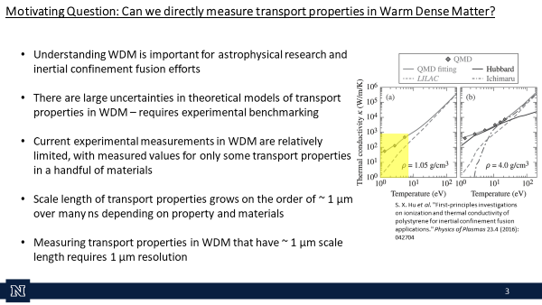
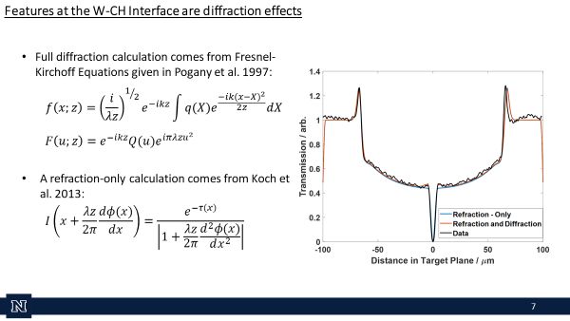
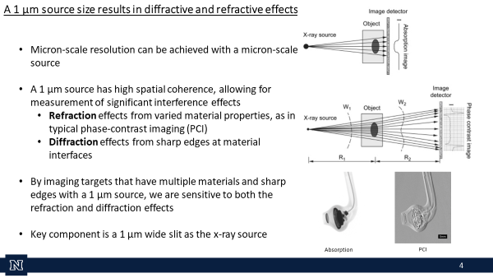
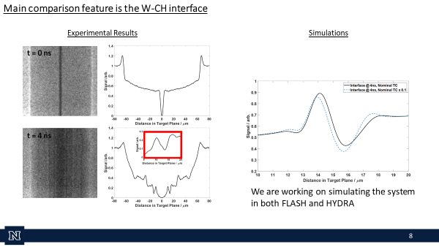
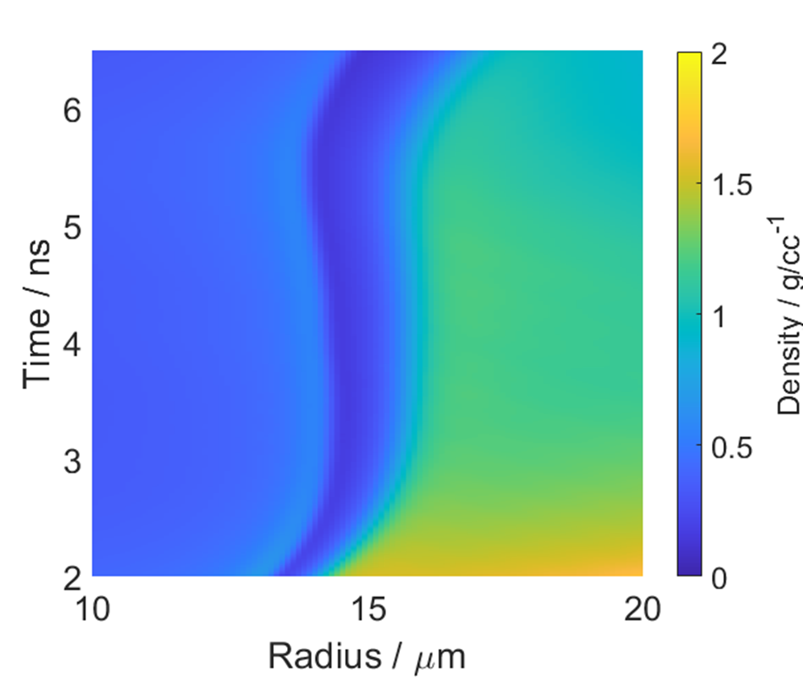
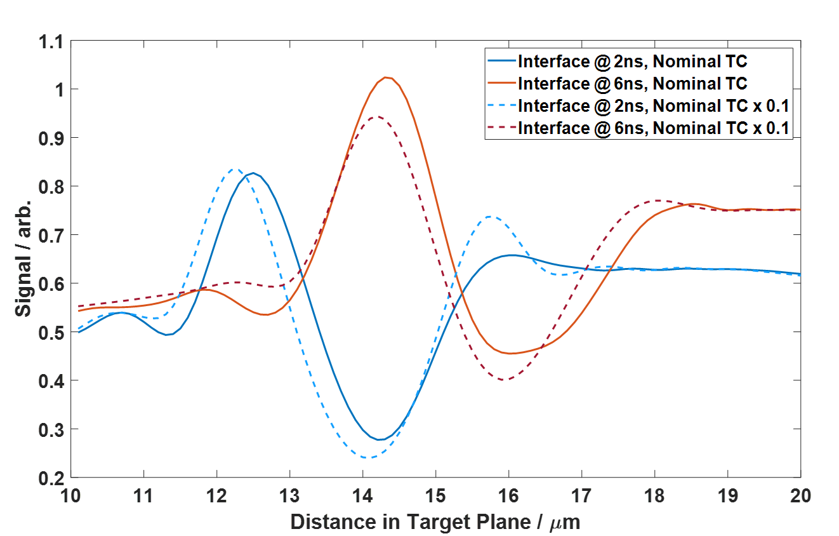
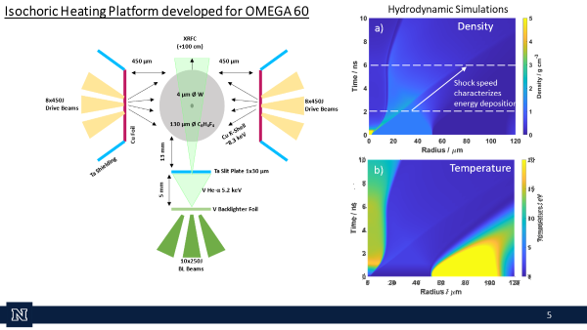
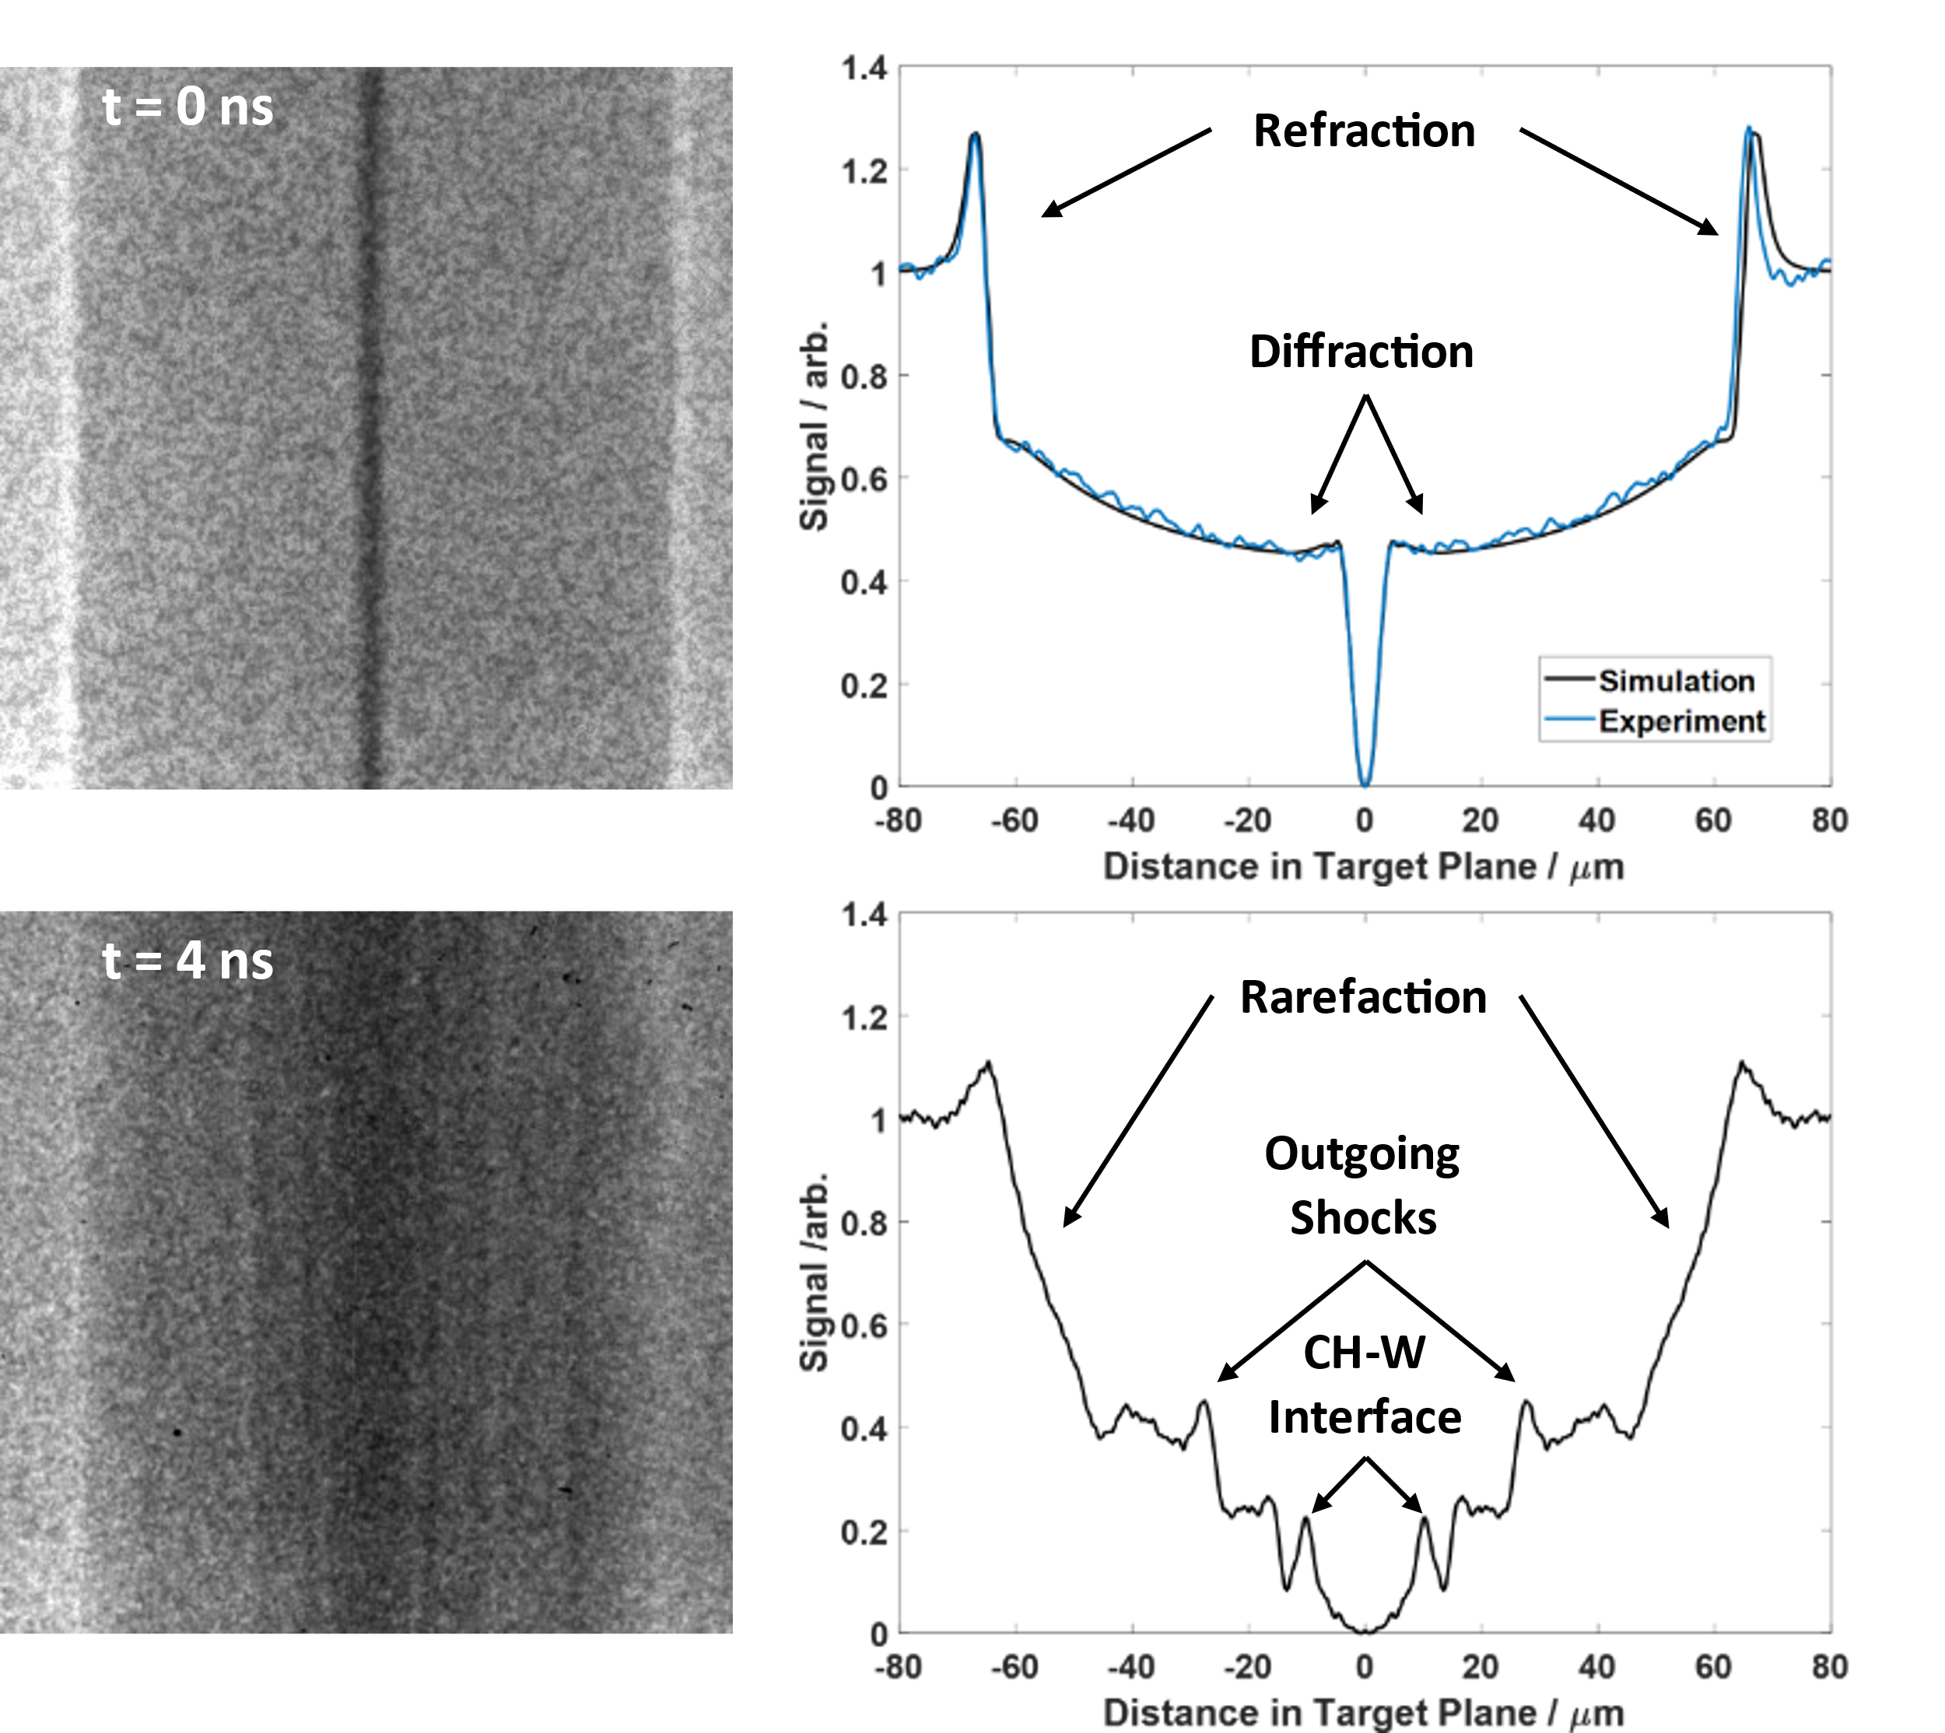
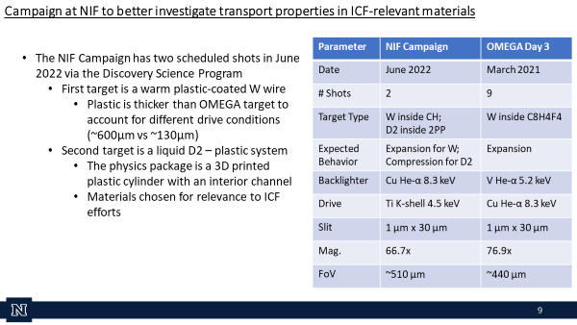
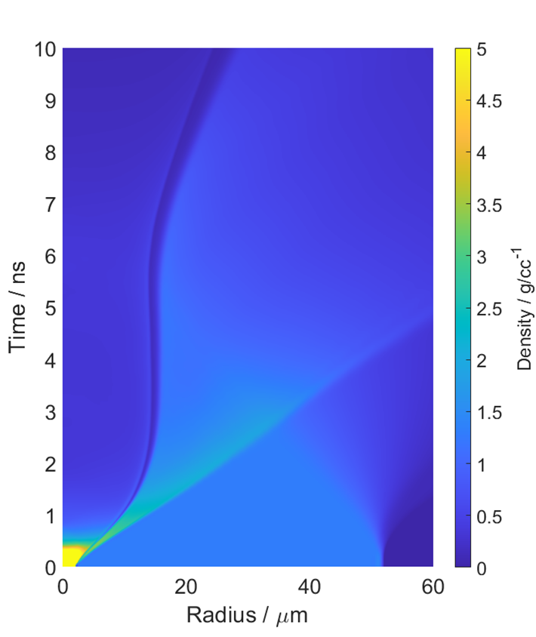
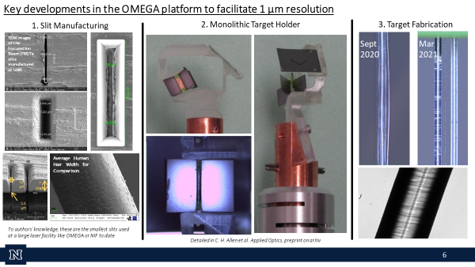
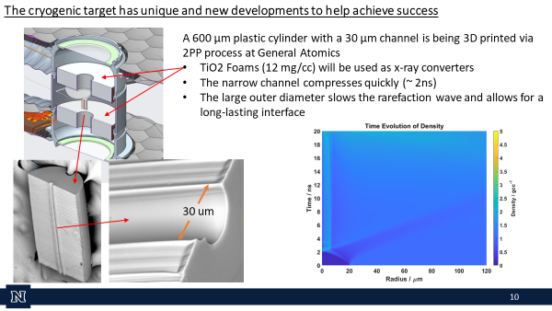
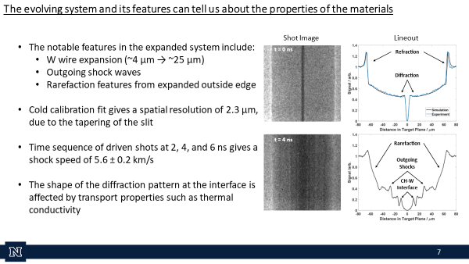
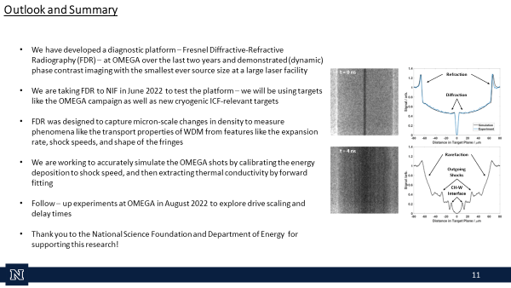
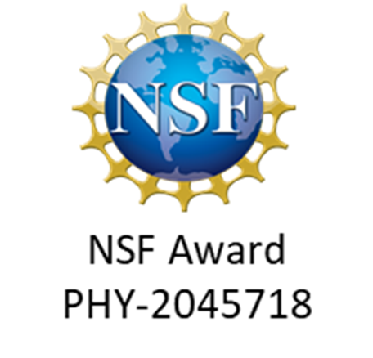



Transport Property Experiments at OMEGA and NIF
Cameron H. Allen¹, Matthew Oliver², Laurent Divol³, Andreas Kemp³, Otto L. Landen³, Yuan Ping³, Markus Schölmerich³, Wolfgang Theobald⁴, Thomas G. White¹, and Tilo Döppner³
^{1.} University of Nevada, Reno, NV ^{2.} Science and Technology Facilities Council, UK ^{3.} Lawrence Livermore National Laboratory, CA ^{4.} Laboratory for Laser Energetics, NY
The evolution of an interface between two warm dense matter materials will be influenced by the materials’ equations of state and transport properties, such as thermal conductivity.
By coupling an isochorically-heated system to a highly coherent radiography platform, we can measure changes in the density profile to learn about these processes and provide experimental benchmarks for theoretical models.
The early time behavior of the interface is governed by pressure gradients.
After pressure equilibration, a temperature gradient remains, allowing thermal conductivity to influence the shape and position of the interface.
With a highly coherent source, we can image these fringes with high resolution to extract information about the thermal conductivity
The work of Y.P., L.D., O.L., M.S., A.K., and T.D. was performed under the auspices of the U.S. Department of Energy by Lawrence Livermore National Laboratory under Contract DE-AC52-07NA27344 and supported by Laboratory Directed Research and Development (LDRD) Grant No. 21-ERD-029.
This material is based upon work supported by the National Science Foundation under Grant No. PHY-2045718

Slide 2
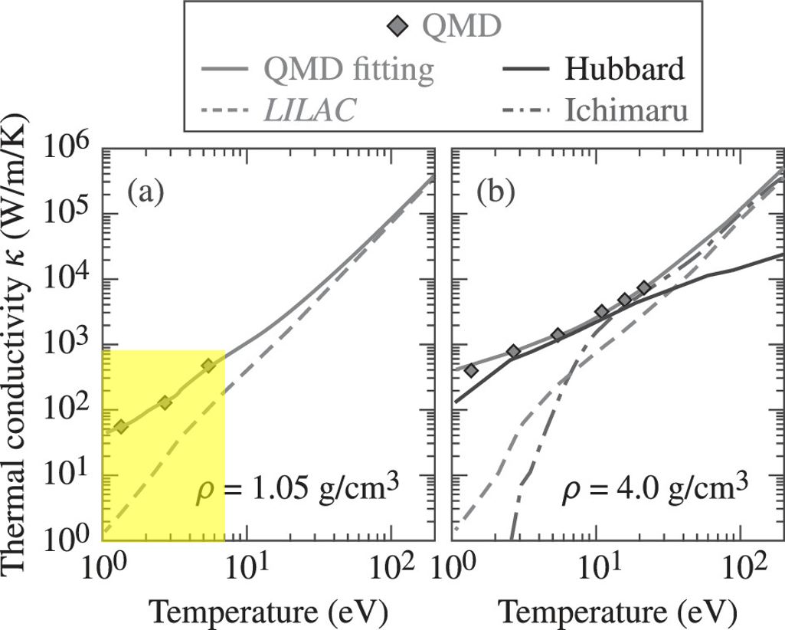
Motivating Question: Can we directly measure transport properties in Warm Dense Matter?
Understanding WDM is important for astrophysical research and inertial confinement fusion efforts
There are large uncertainties in theoretical models of transport properties in WDM – requires experimental benchmarking
Current experimental measurements in WDM are relatively limited, with measured values for only some transport properties in a handful of materials
Scale length of transport properties grows on the order of ~ 1 µm over many ns depending on property and materials
Measuring transport properties in WDM that have ~ 1 µm scale length requires 1 µm resolution
S. X. Hu et al. "First-principles investigations on ionization and thermal conductivity of polystyrene for inertial confinement fusion applications." Physics of Plasmas 23.4 (2016): 042704
2

Slide 3
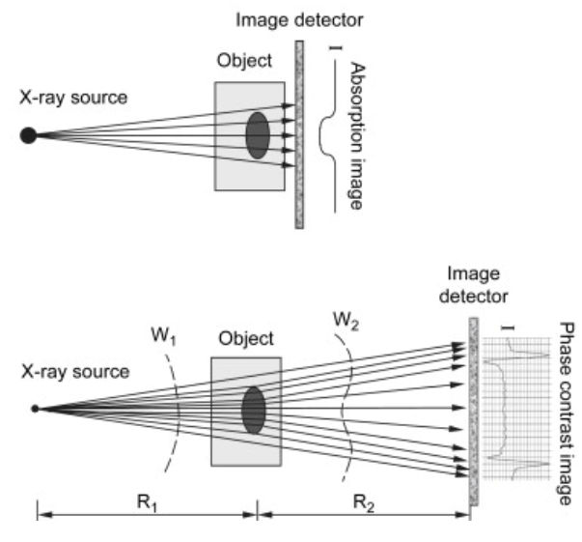
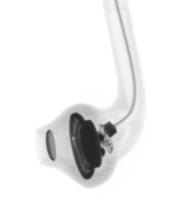
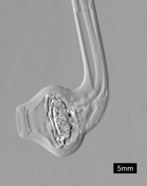
A 1 µm source size results in diffractive and refractive effects
A 1 µm source has high spatial coherence, allowing for measurement of significant interference effects
  Refraction effects from varied material properties, as in typical phase-contrast imaging (PCI)
  Diffraction effects from sharp edges at material interfaces
By imaging targets that have multiple materials and sharp edges with a 1 µm source, we are sensitive to both the refraction and diffraction effects
Key component is a 1 µm wide slit as the x-ray source
This leads to Fresnel Diffractive-Refractive Radiography (FDR)
Absorption
PCI
3
Notes:
The small source improves the spatial coherence of the beam such that we can (in 1D) observe interference effects from refractive and diffractive effects.
Refraction: Waves changing velocity due to the refractive index of the material (Some papers refer to this regime as having X-rays that propagate straight through the target but change phase).
Diffraction: X-rays that change direction at the target. Does not require a refractive index gradient. i.e., a knife edge or aperture would diffract.
Fourier transform of the complex transmission function
In this regime, as you can see from equation 5, the intensity is proportional to the Laplacian of the phase (or, because phase-change and density are related in a plasma imaged with hard X-rays, the Laplacian of density). Phase-contrast imaging and refraction enhanced imaging seem to be synonymous in the literature.
People use the phrase absorption contrast imaging to mean any situation where the detector is located near the target, or the source size is large, so there are no interference effects. In this case, the signal is only proportional to absorption in the material (i.e., Beer’s Law type equations).
These two situations cover 95% of what you read about in the literature. We are in neither of these. We have significant phase and absorption effects, but we also place the detector far from the sample. What we have is called Fresnel diffraction, it covers all the above, and the correct way to deal with this is to solve the Fresnel-Kirchoff integral (i.e., Pogany et al. equation (2)). For the record, this is what the code does.
Some people have tried to modify the refraction equation (i.e., the Lapalcian one) to add in absorption without dealing with diffraction and the full Fresnel-Kirchoff integral. This is useful as diffraction isn’t that important unless you have small sharp features. Nino and colleagues claims to have been the most successful at this: https://www.osapublishing.org/josaa/abstract.cfm?uri=josaa-30-7-1460
Equation (10) in Nino’s paper would, in theory, be refraction ONLY. I have coded this up. As you can see, the refraction approximation gets the CH-vacuum interface correct. However, around the W wire, we have significant features that I would attribute to diffraction.
Finally, this paper has some interesting points on Fresnel diffraction: https://www.ncbi.nlm.nih.gov/pmc/articles/PMC5458972/
Importantly, it talks about the need for spatial coherence and the lack of need for chromatic coherence (i.e., we can use polychromatic X-rays, i.e., 4-6 keV X-rays give the same pattern, which we already knew). It does say that Fresnel diffraction is the near-field approximation (i.e., just one fringe) of Kirchhoff–Fresnel diffraction (many fringes).

Slide 4
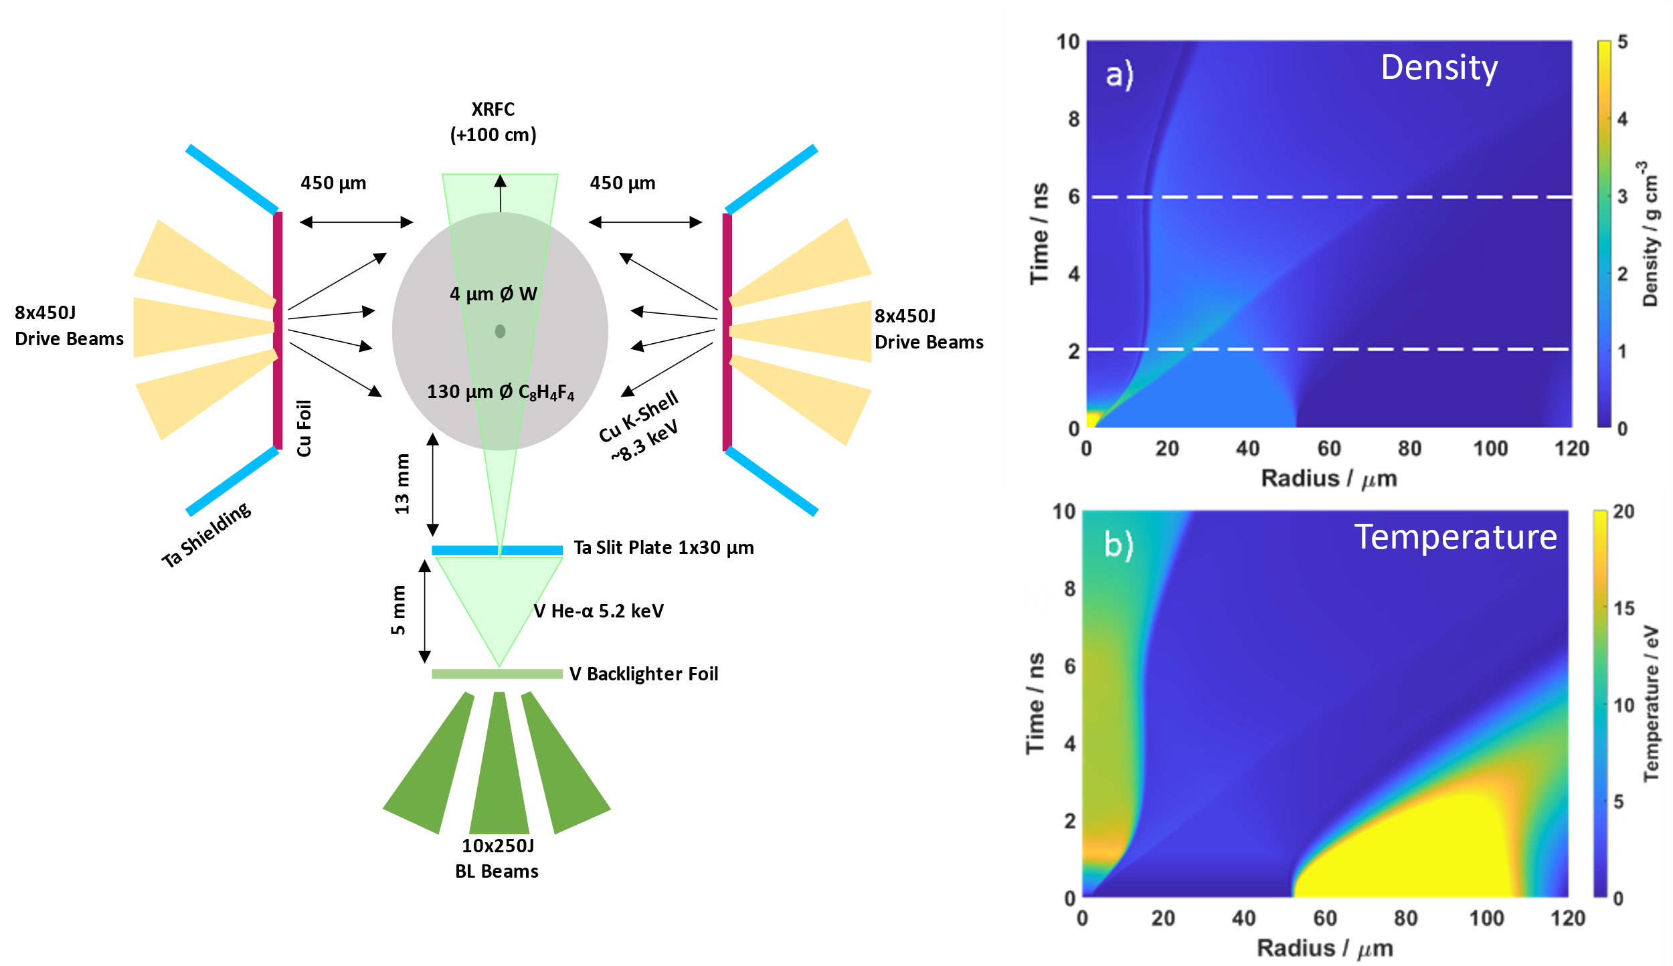
Isochoric Heating Platform developed for OMEGA 60
Hydrodynamic Simulations
Shock speed characterizes
energy deposition
HYDRA Simulations by Laurent Divol (LLNL)
4

Slide 5
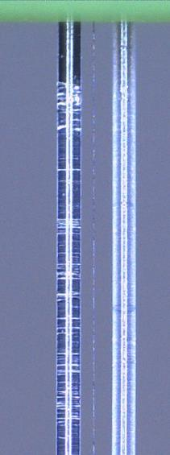
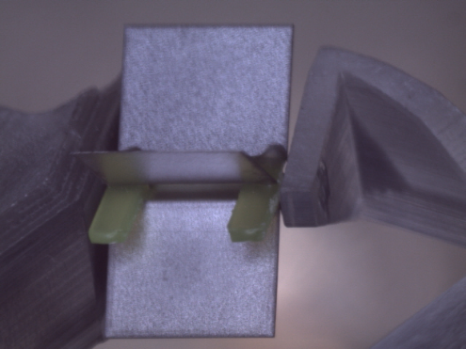
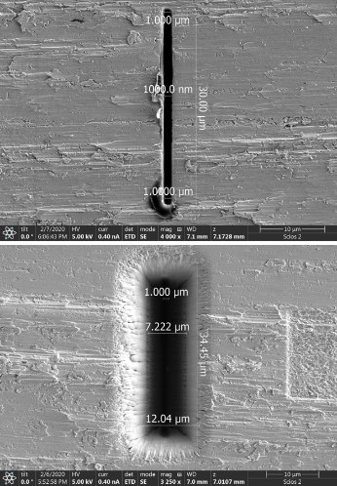
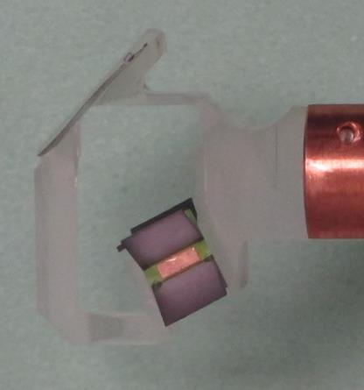
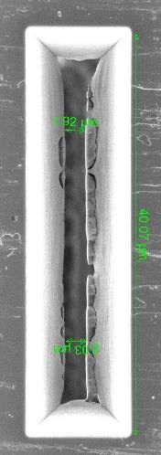
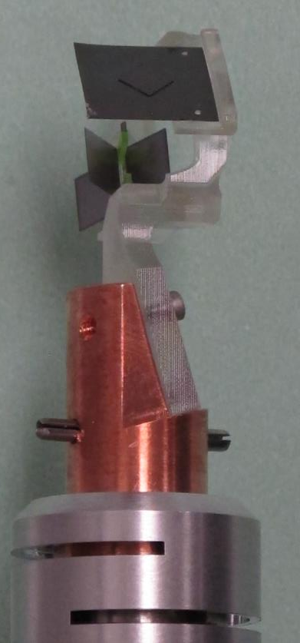
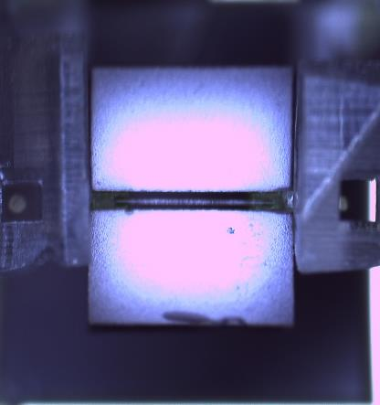
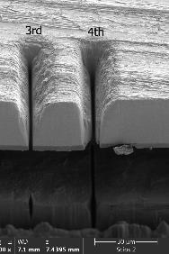
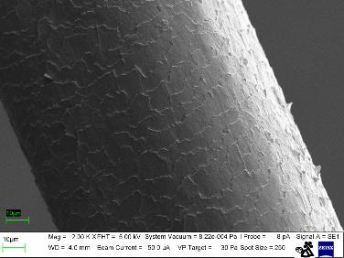
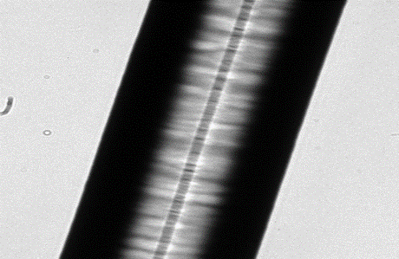
Key developments in the OMEGA platform to facilitate 1 µm resolution
1. Slit Manufacturing
2. Monolithic Target Holder
3. Target Fabrication
SEM images of the Focused Ion Beam (FIB) Ta slits manufactured at UNR
Sept 2020
Mar
2021
Average Human Hair Width for Comparison
10 µm
Ta
30 µm
1.5 µm
To authors’ knowledge, these are the smallest slits used at a large laser facility like OMEGA or NIF to date
Detailed in C. H. Allen et al. Applied Optics, preprint on arXiv
5

Slide 6
The evolving system and its features can tell us about the properties of the materials
Shot Image
Lineout
The notable features in the expanded system include:
  W wire expansion (~4 μm → ~25 μm)
  Outgoing shock waves
  Rarefaction features from expanded outside edge
Cold calibration fit gives a spatial resolution of 2.3 μm, due to the tapering of the slit
Time sequence of driven shots at 2, 4, and 6 ns gives a shock speed of 5.6 ± 0.2 km/s
The shape of the diffraction pattern at the interface is affected by transport properties such as thermal conductivity
6

Slide 7
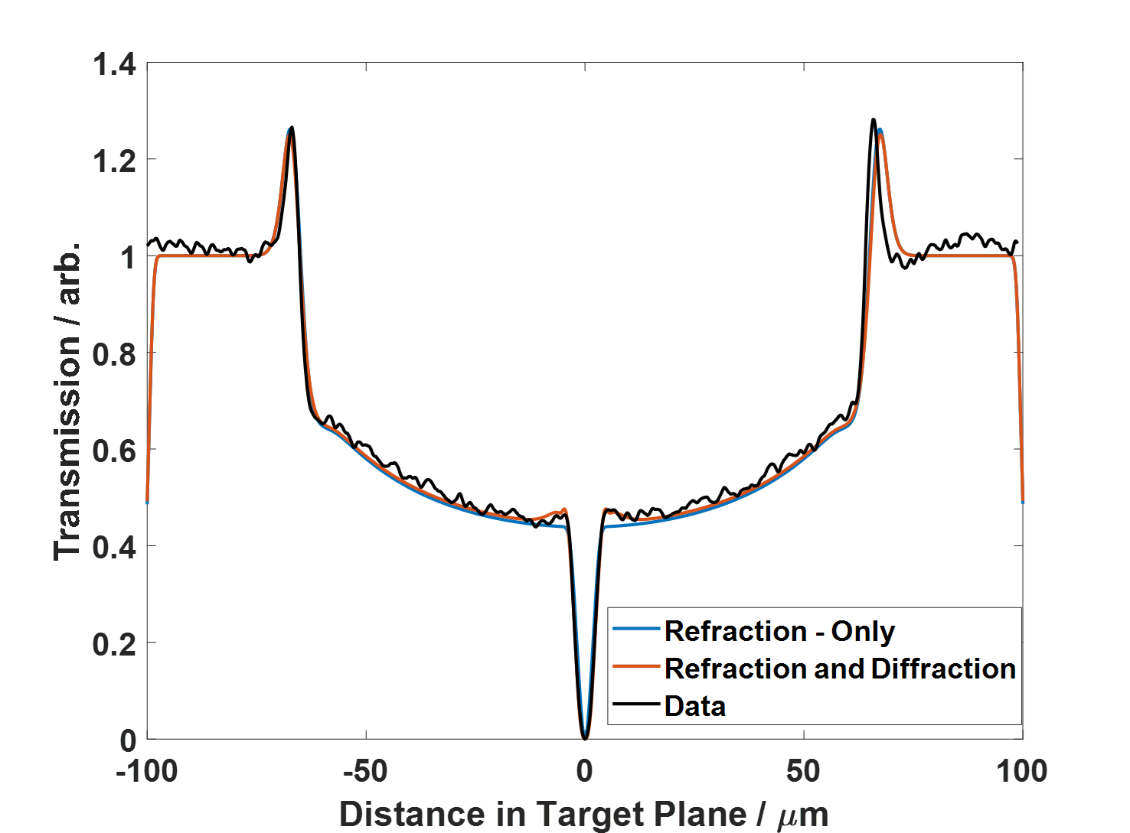
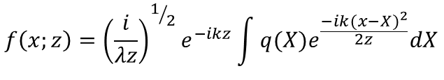
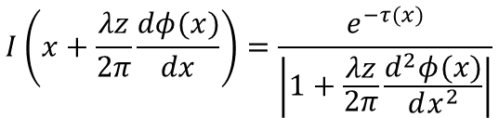

Features at the W-CH Interface are diffraction effects
Full diffraction calculation comes from Fresnel- Kirchoff Equations given in Pogany et al. 1997:
A refraction-only calculation comes from Koch et al. 2013:
$$f\left(x;z\right)={\left(\frac{i}{λz}\right)}^{1/2}e^{−ikz}\int{q(X)e^{\frac{−ik{(x−X)}^{2}}{2z}}dX}$$
$$F\left(u;z\right)=e^{−ikz}Q(u)e^{iπλzu^{2}}$$
$$I\left(x+\frac{λz}{2π}\frac{dφ(x)}{dx}\right)=\frac{e^{−τ(x)}}{\left|1+\frac{λz}{2π}\frac{d^{2}φ(x)}{dx^{2}}\right|}$$
7

Slide 8
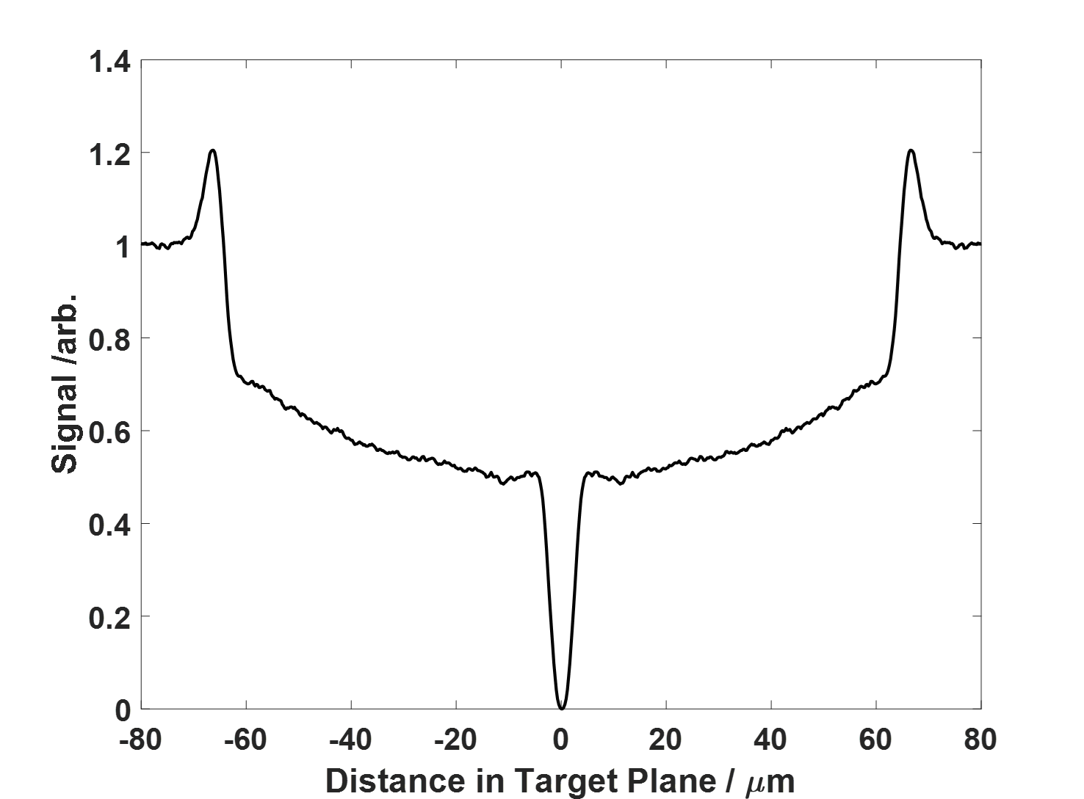
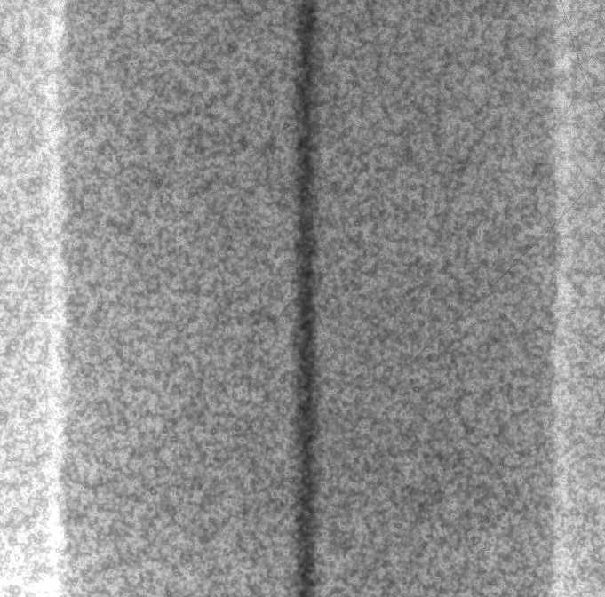
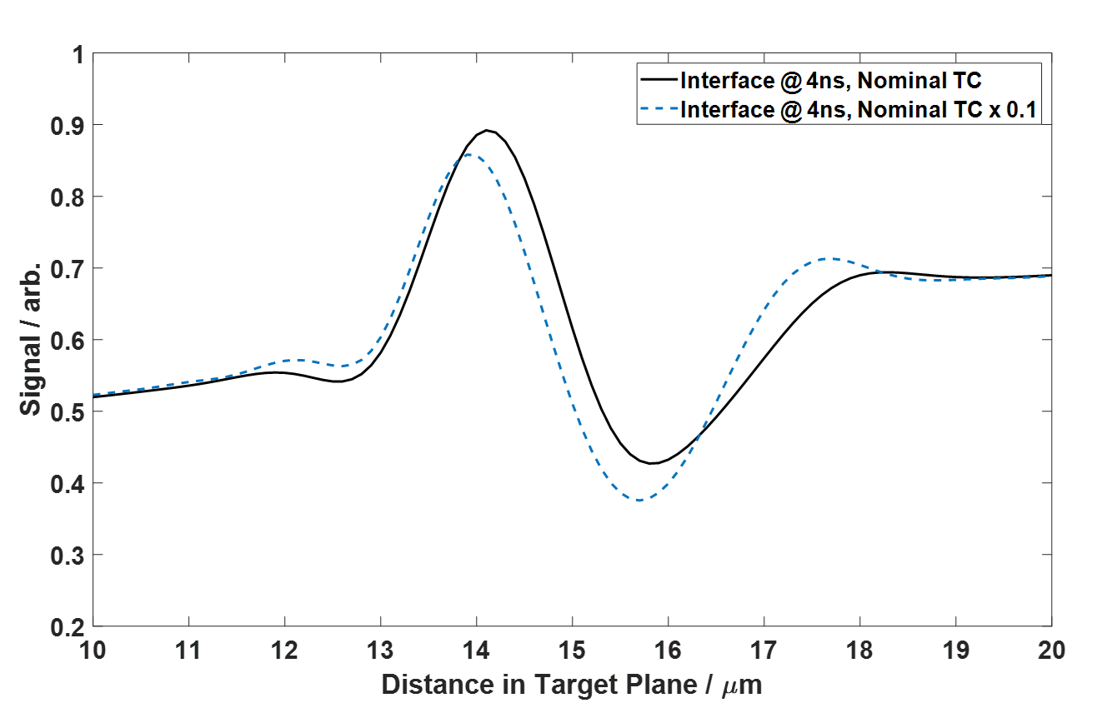
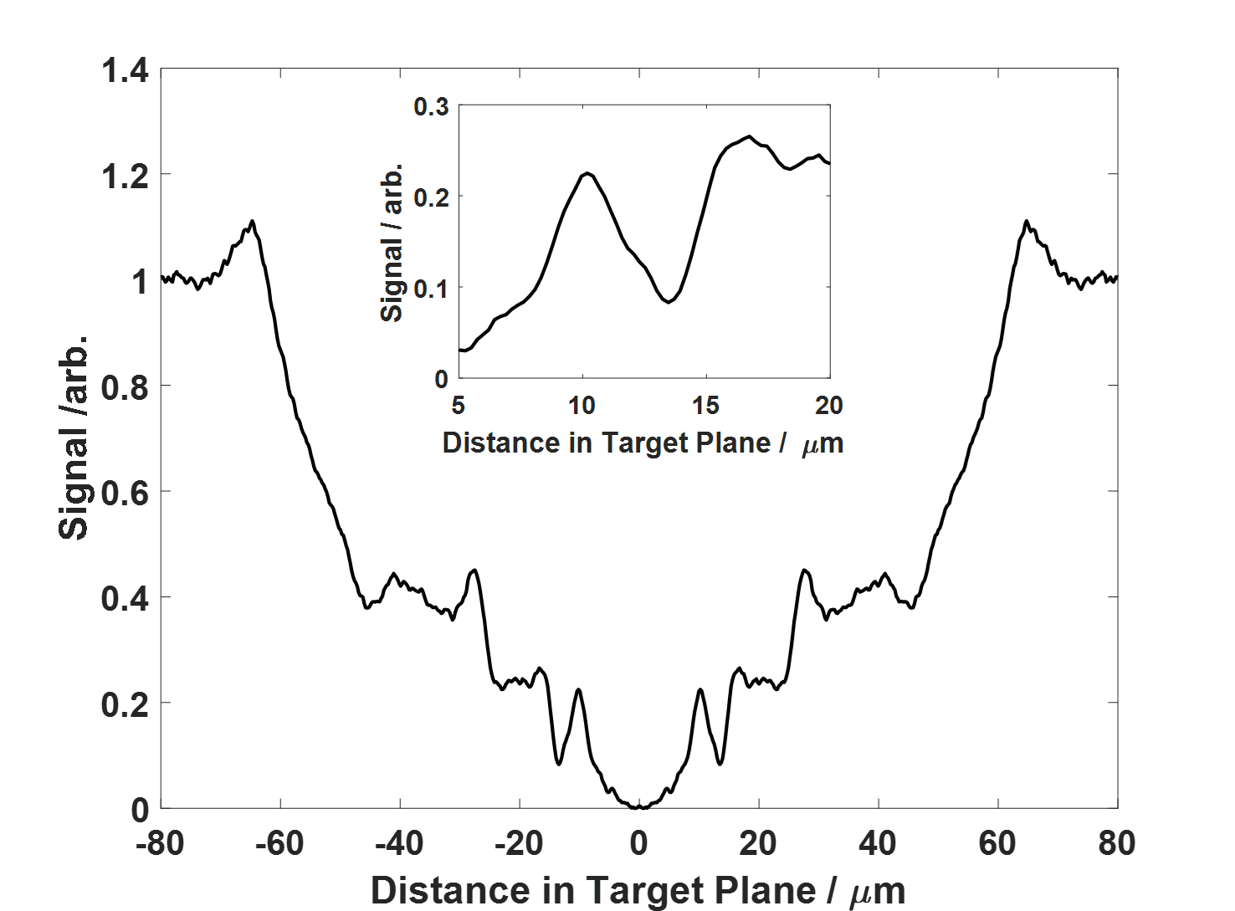
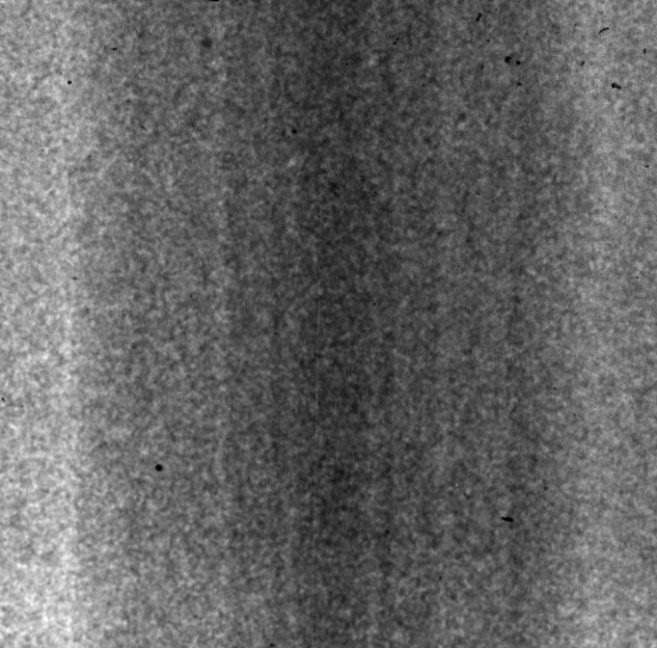
Main comparison feature is the W-CH interface
Experimental Results
Simulations
t = 0 ns
t = 4 ns
We are working on simulating the system in both FLASH and HYDRA
8

Slide 9
Campaign at NIF to better investigate transport properties in ICF-relevant materials
Parameter | NIF Campaign | OMEGA Day 3
Date | June 2022 | March 2021
# Shots | 2 | 9
Target Type | W inside CH; D2 inside 2PP | W inside C8H4F4
Expected Behavior | Expansion for W; Compression for D2 | Expansion
Backlighter | Cu He-α 8.3 keV | V He-α 5.2 keV
Drive | Ti K-shell 4.5 keV | Cu He-α 8.3 keV
Slit | 1 μm x 30 μm | 1 μm x 30 μm
Mag. | 66.7x | 76.9x
FoV | ~510 μm | ~440 μm
The NIF Campaign has two scheduled shots in June 2022 via the Discovery Science Program
  First target is a warm plastic-coated W wire
    Plastic is thicker than OMEGA target to account for different drive conditions (~600μm vs ~130μm)
  Second target is a liquid D2 – plastic system
    The physics package is a 3D printed plastic cylinder with an interior channel
    Materials chosen for relevance to ICF efforts
9

Slide 10
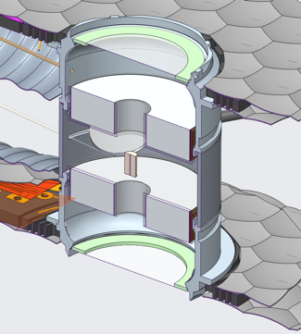
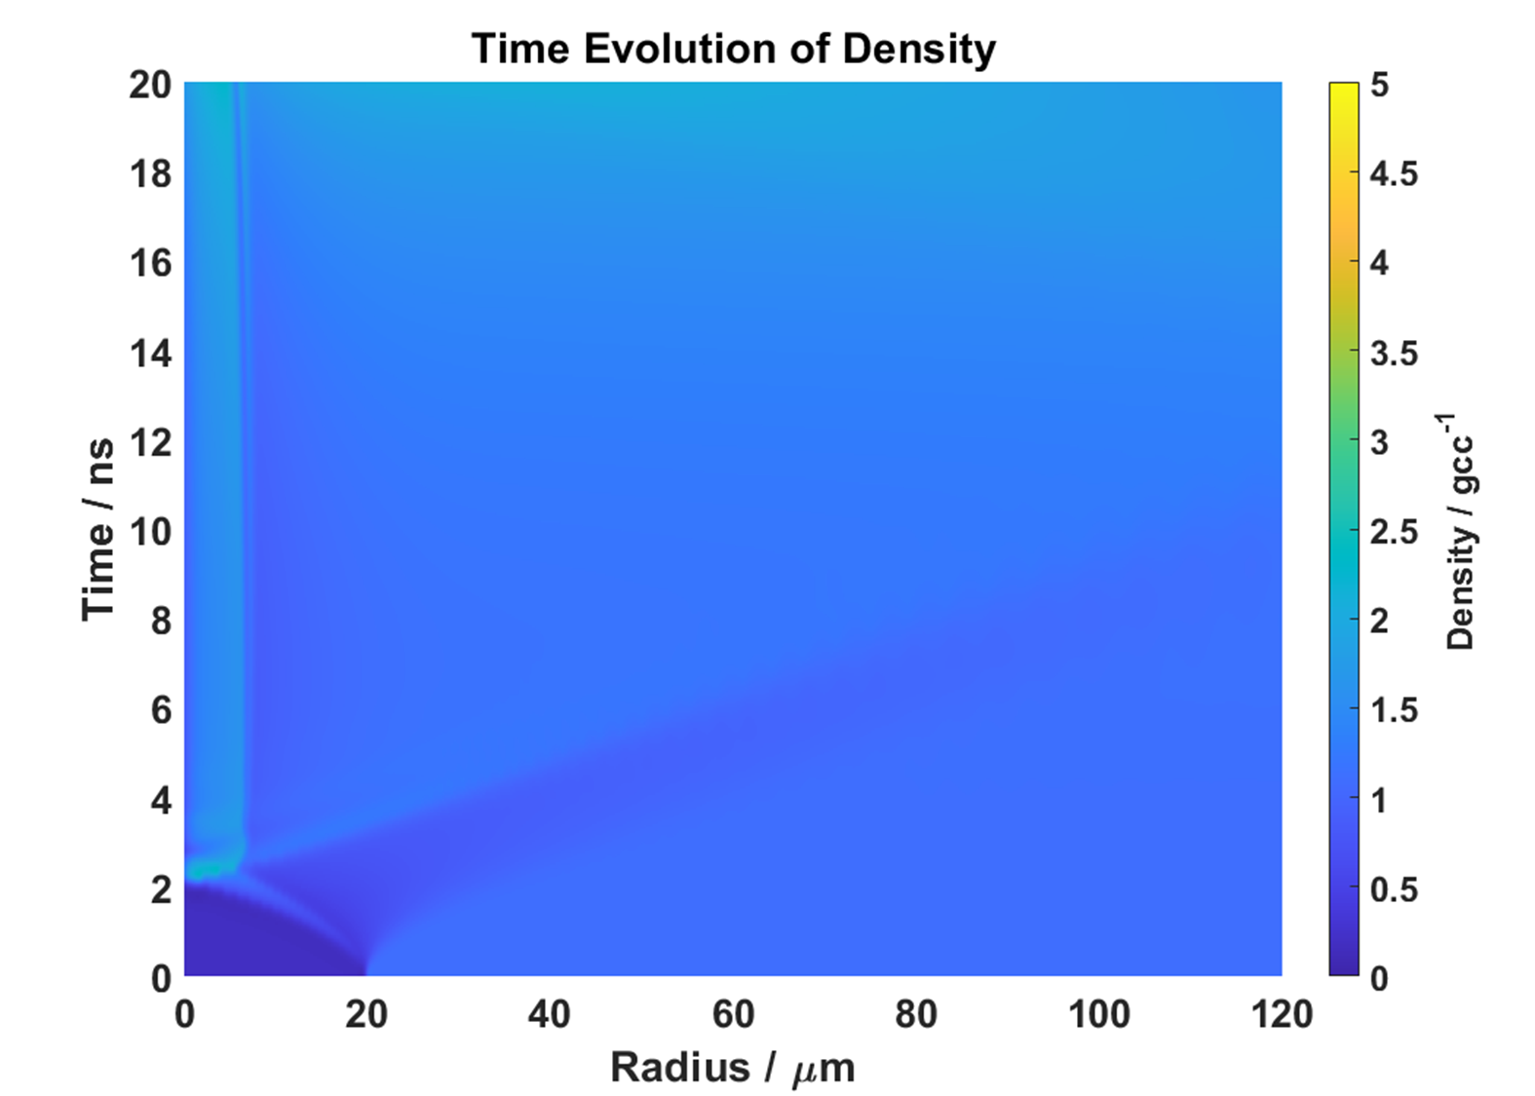
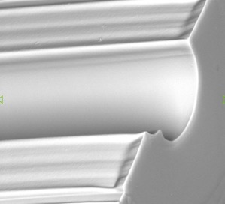
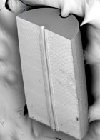
The cryogenic target has unique and new developments to help achieve success
A 600 μm plastic cylinder with a 30 μm channel is being 3D printed via 2PP process at General Atomics
TiO2 Foams (12 mg/cc) will be used as x-ray converters
The narrow channel compresses quickly (~ 2ns)
The large outer diameter slows the rarefaction wave and allows for a long-lasting interface
Shock speed characterizes
energy deposition
30 um
10

Slide 11
Outlook and Summary
We have developed a diagnostic platform – Fresnel Diffractive-Refractive Radiography (FDR) – at OMEGA over the last two years and demonstrated (dynamic) phase contrast imaging with the smallest ever source size at a large laser facility
We are taking FDR to NIF in June 2022 to test the platform – we will be using targets like the OMEGA campaign as well as new cryogenic ICF-relevant targets
FDR was designed to capture micron-scale changes in density to measure phenomena like the transport properties of WDM from features like the expansion rate, shock speeds, and shape of the fringes
We are working to accurately simulate the OMEGA shots by calibrating the energy deposition to shock speed, and then extracting thermal conductivity by forward fitting
Follow – up experiments at OMEGA in August 2022 to explore drive scaling and delay times
Thank you to the National Science Foundation and Department of Energy for supporting this research!
11

