Slide 1
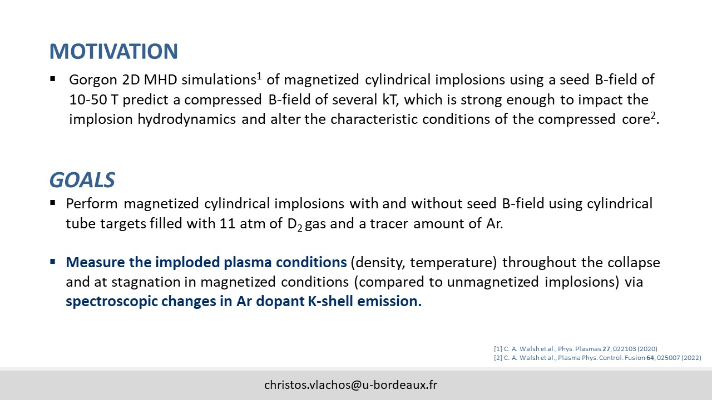
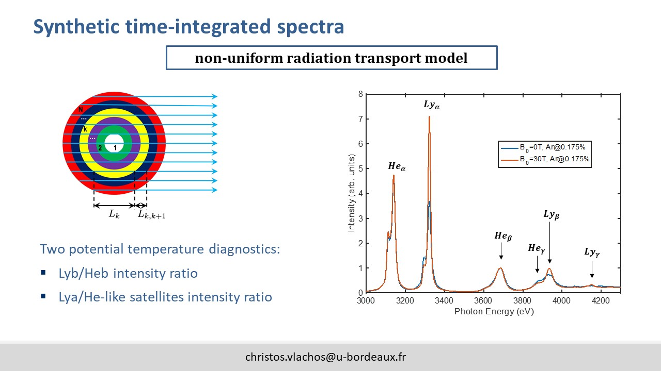
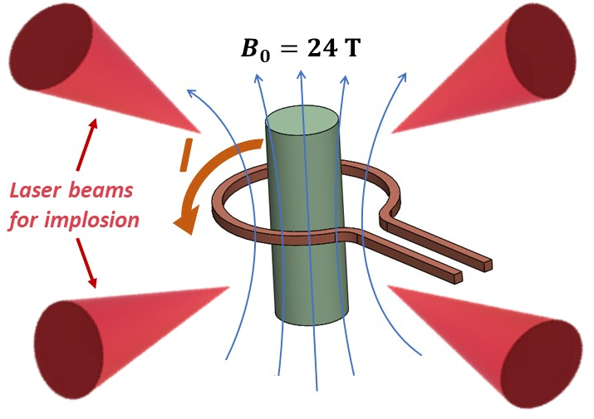
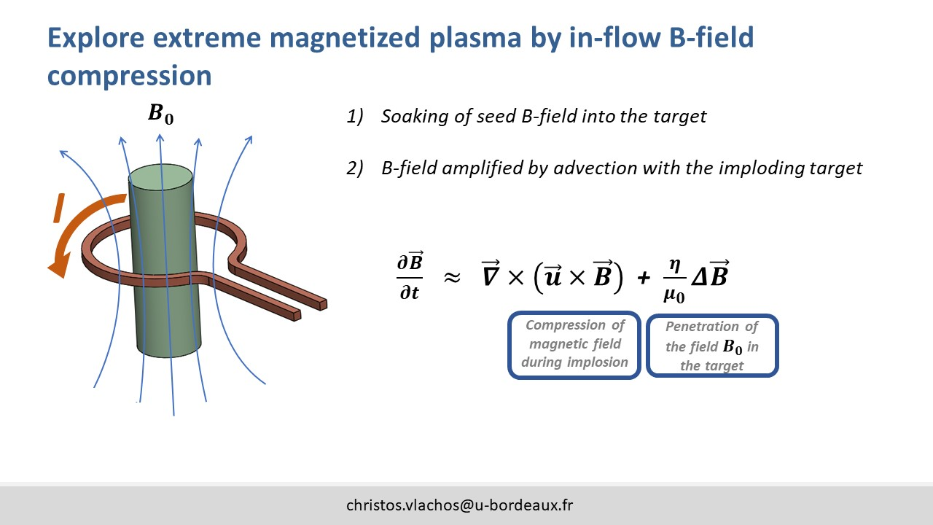
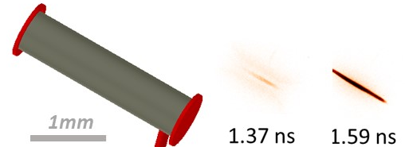
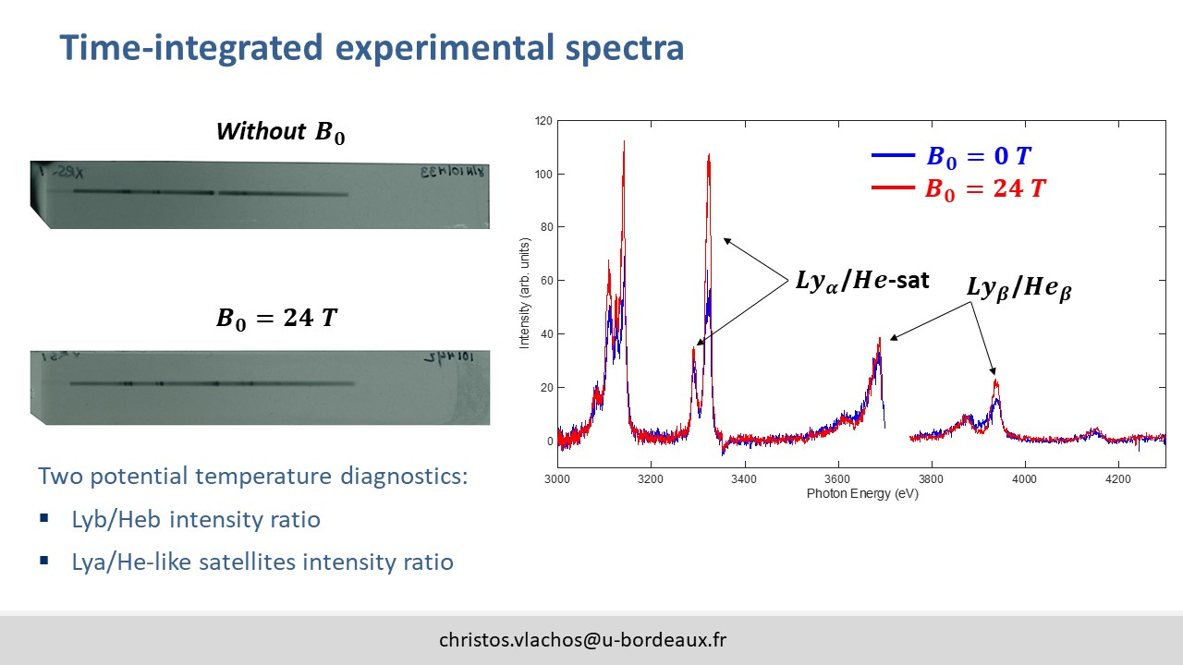
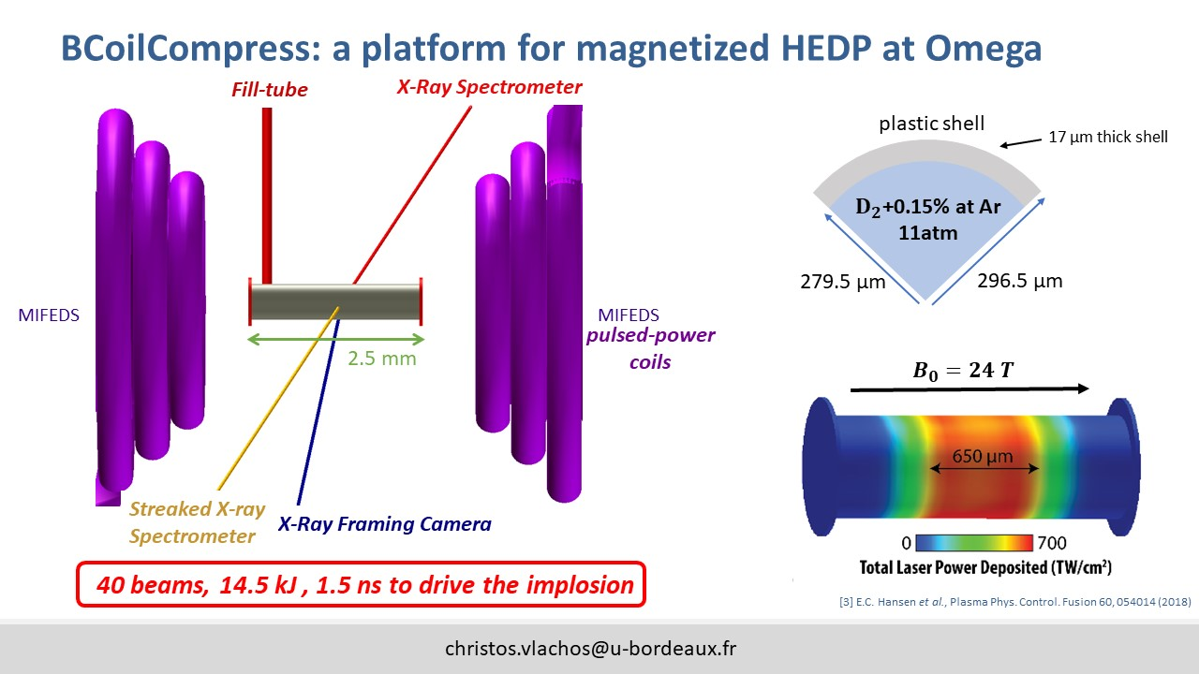
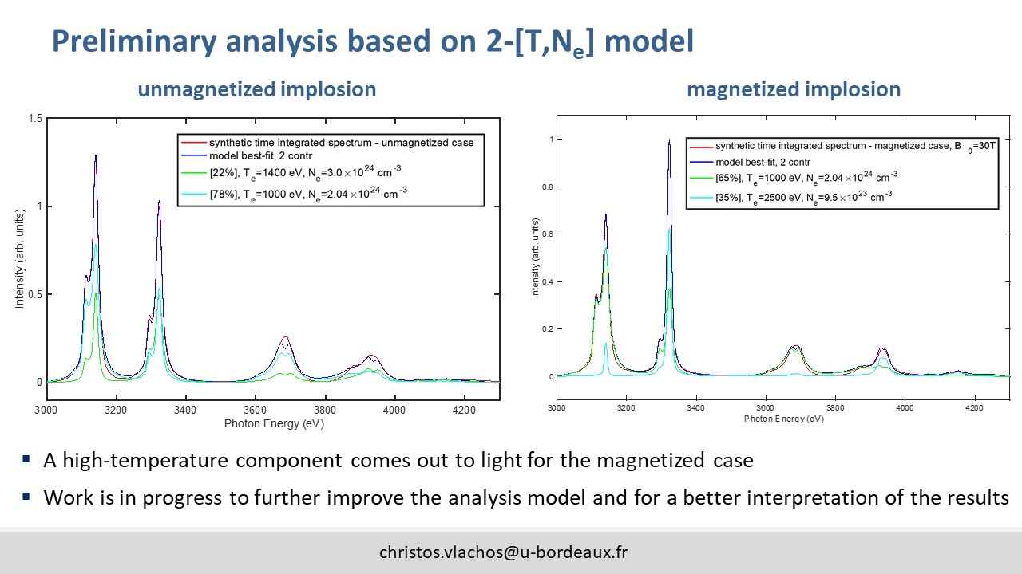
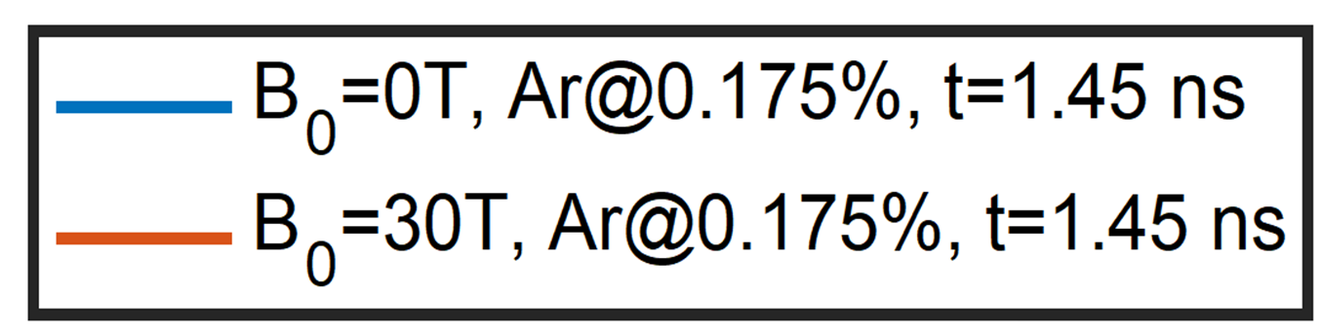
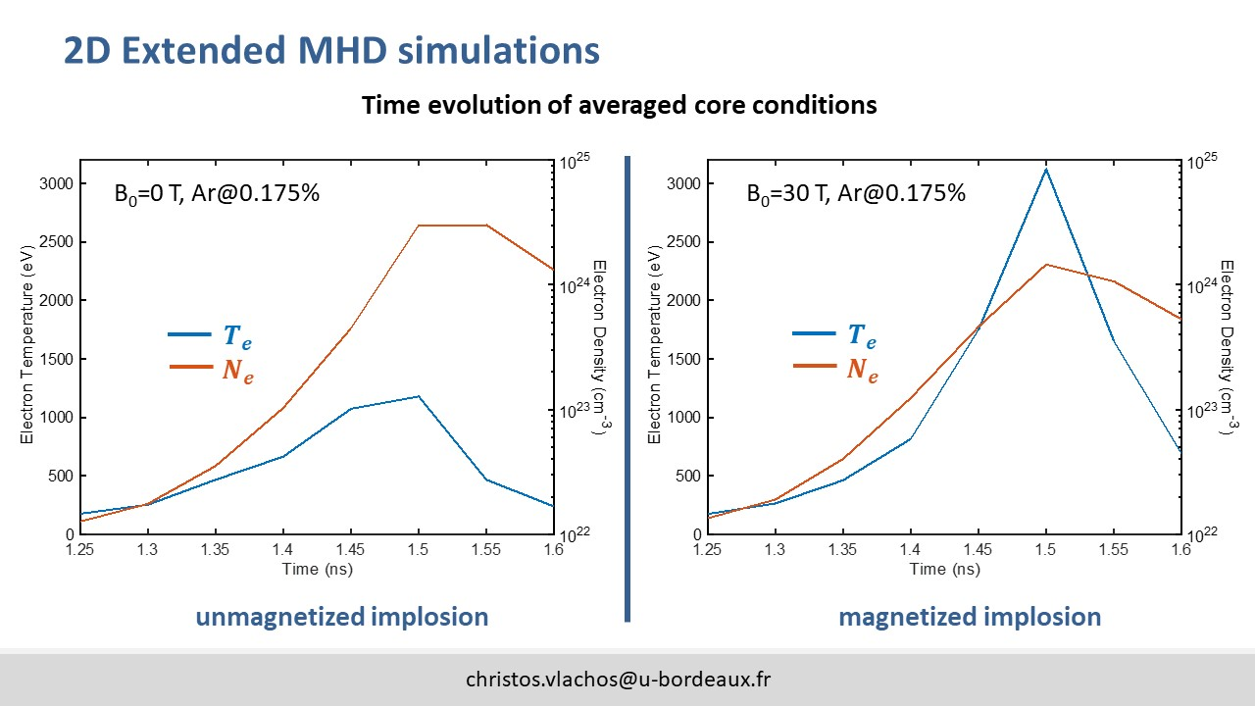
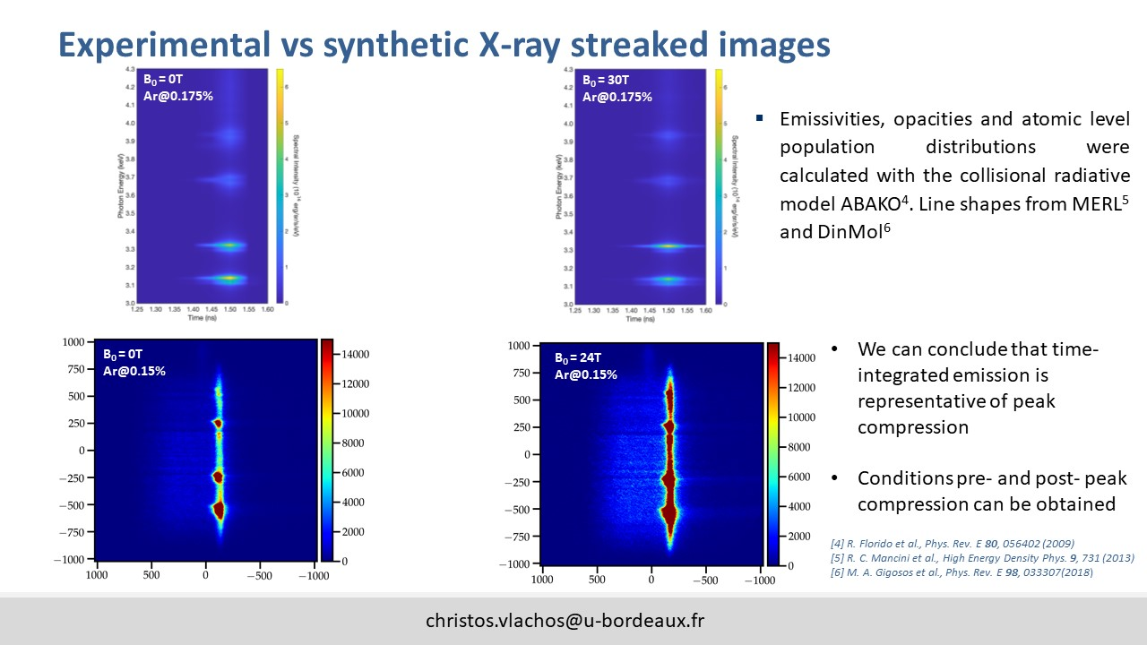
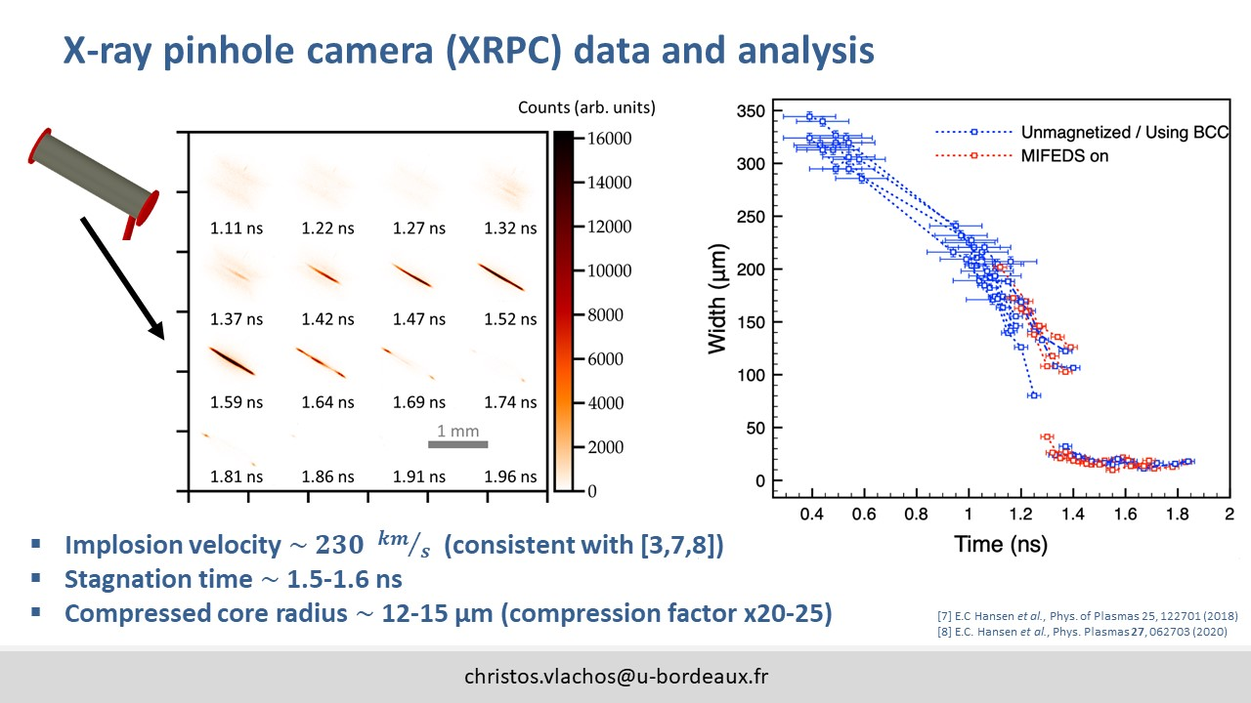















Characterizing strongly magnetized hot dense plasmas in cylindrical implosion experiments
C. Vlachos¹, M. Bailly-Grandvaux², R. Florido³, G. Peréz-Callejo^{1,4}, C.A. Walsh⁵, C. McGuffey⁶, F. Suzuki-Vidal⁷, J. Saret², M.A. Gigosos⁴, P. Bradford¹, R.C. Mancini⁸, F.N. Beg², and J.J. Santos¹
¹ Université de Bordeaux-CNRS-CEA, Centre Lasers Intenses et Applications (CELIA), UMR 5107, Talence, France, ² Center for Energy Research, University of California, San Diego, USA, ³ iUNAT-Departamento de Física, Universidad de Las Palmas de Gran Canaria, Las Palmas de Gran Canaria, Spain, ⁴ Departamento de Física Teórica, Atómica y Óptica, Universidad de Valladolid, Valladolid, Spain, ⁵ Lawrence Livermore National Laboratory, Livermore, USA, ⁶ General Atomics, San Diego, USA, ⁷ Imperial College London, London, UK, ⁸ Department of Physics, University of Nevada, Reno, USA
Explore extreme magnetized plasma
Compression of magnetic field during implosion
$\frac{∂\vec{B}}{∂t} ≈ \vec{∇}×\left(\vec{u}×\vec{B}\right)$+ $\frac{η}{μ_{0}}Δ\vec{B}$
X-ray pinhole camera data
Penetration of the field $B_{0}$ in the target
At stagnation  $r_{min} \sim 15 μm$
● ${ t}_{BT} \sim 1.6 ns$
Ar-doped target
Experimental Spectra
Synthetic Spectra (at $r \sim 15 μm$)
$B_{0}=0 T$
$B_{0}=24 T$
${Ly}_{α}$/$He$-sat
${Ly}_{β}$/ ${He}_{β}$
Reproducible Ar-doping K-shell line emission spectra evidence impact of seed B-field on the implosion hydrodynamics and the compressed core plasma conditions
Preliminary synthetic spectra fairly reproduce the experimental observations. Extended MHD sims and advanced atomic kinetic calculations were used [1]
[1] C. A. Walsh et al., Plasma Phys. Control. Fusion 64, 025007 (2022)
Work supported by the DOE Office of Science Grant No. DE-SC0022250, by NNSA/NLUF Grant No. DE-NA0003940, Grant No. PID2019-108764RB-I00 (MICINN, Spain), and EUROfusion Consortium under Grant No. 101052200.

