Slide 1



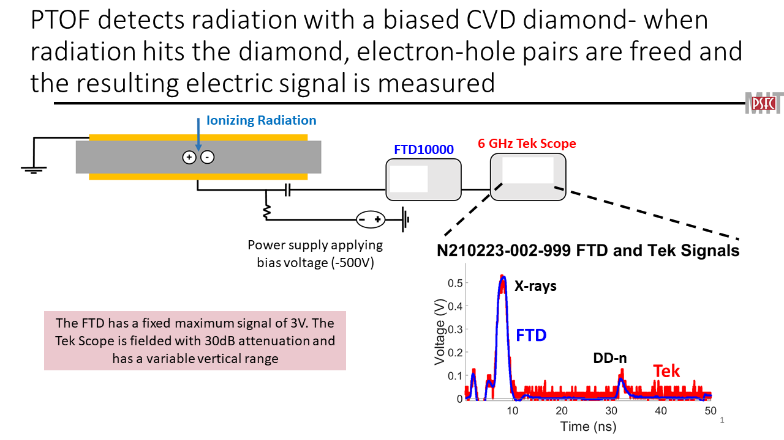
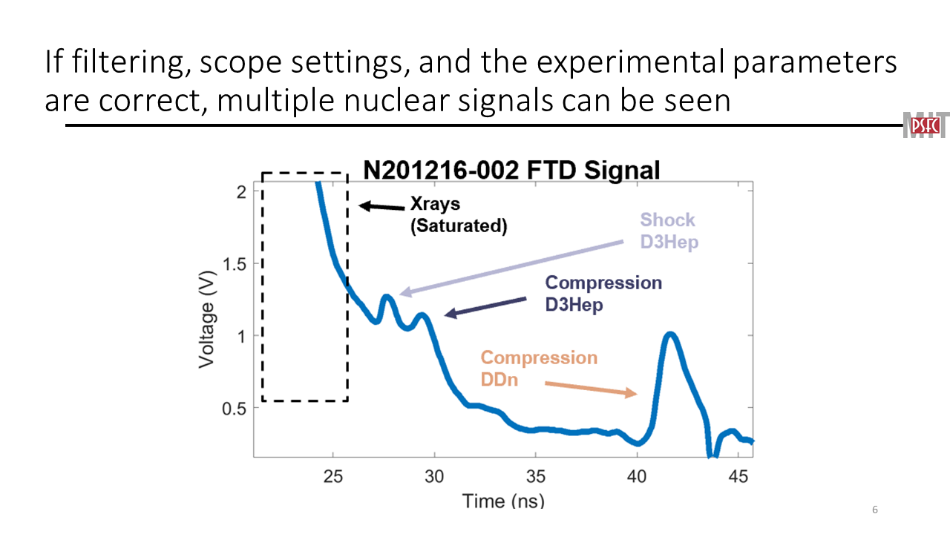
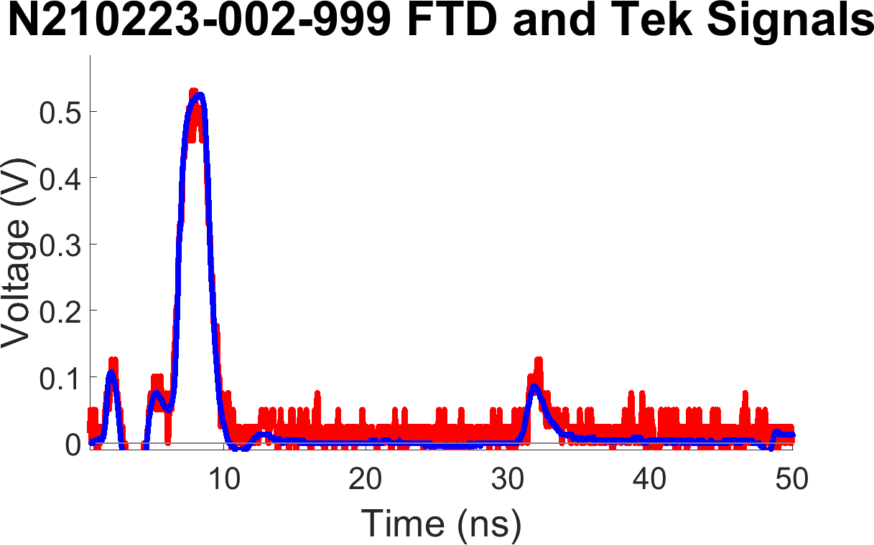
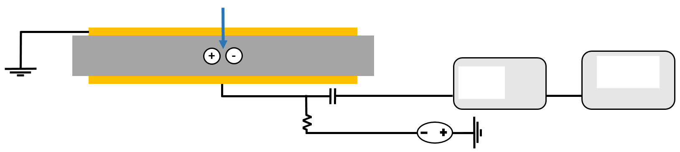
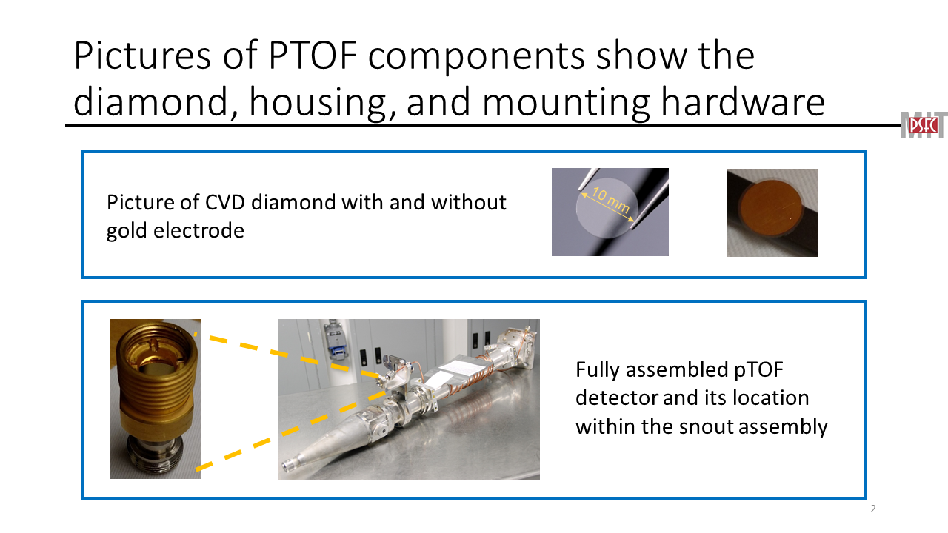
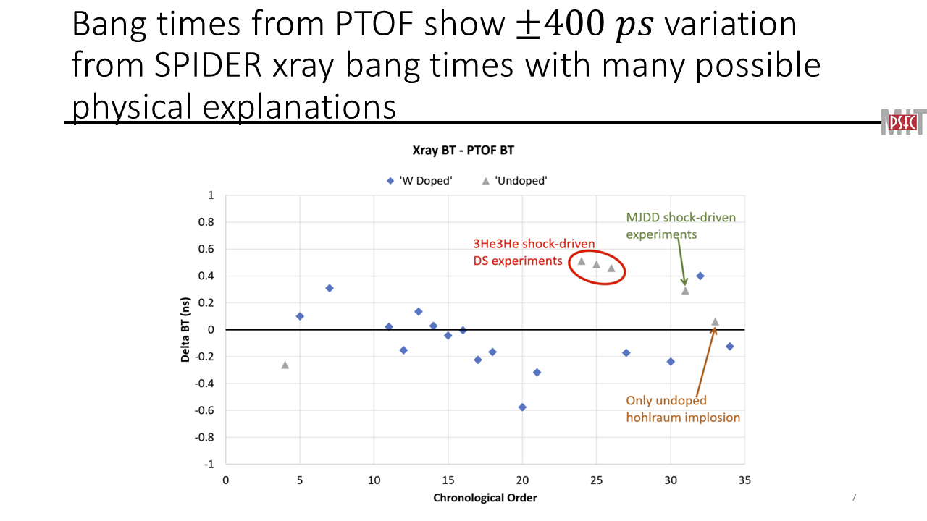
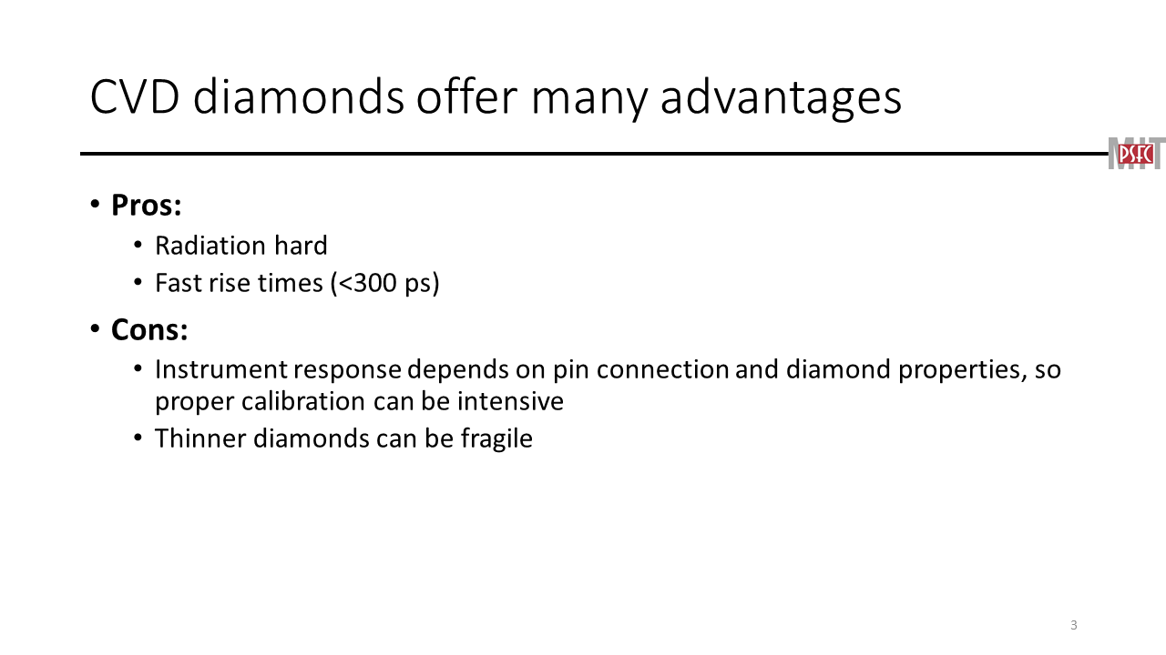
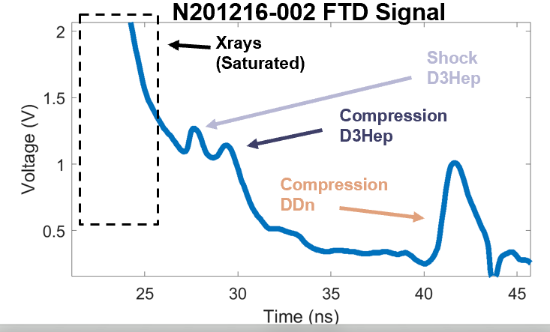
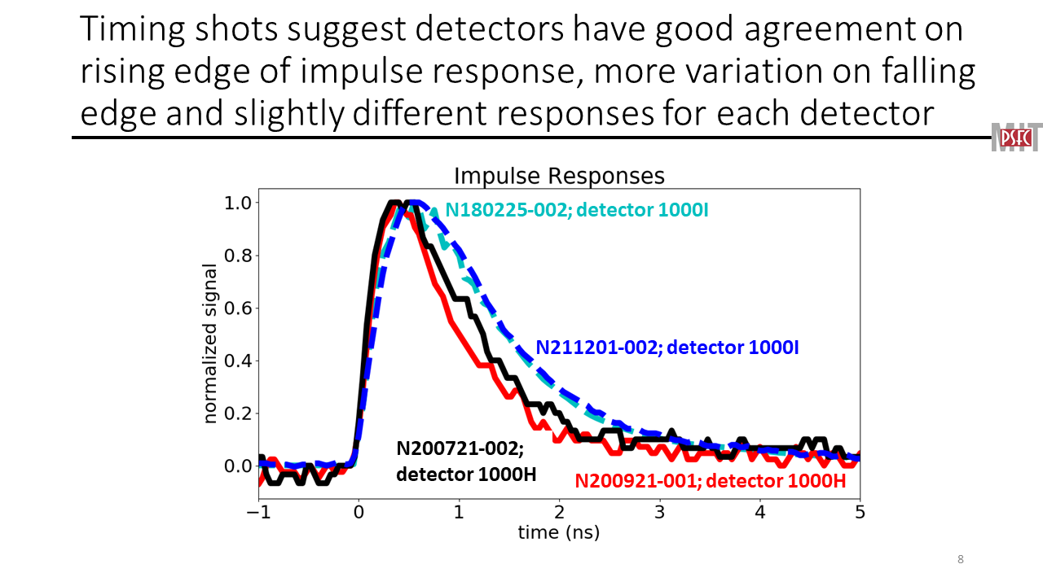
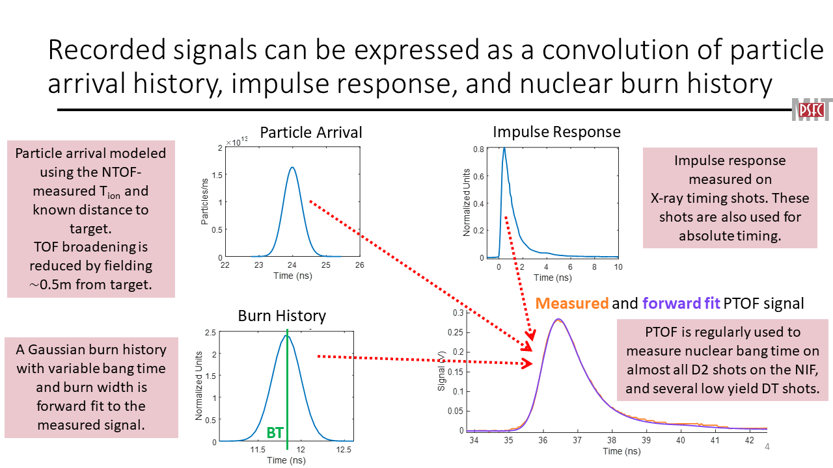
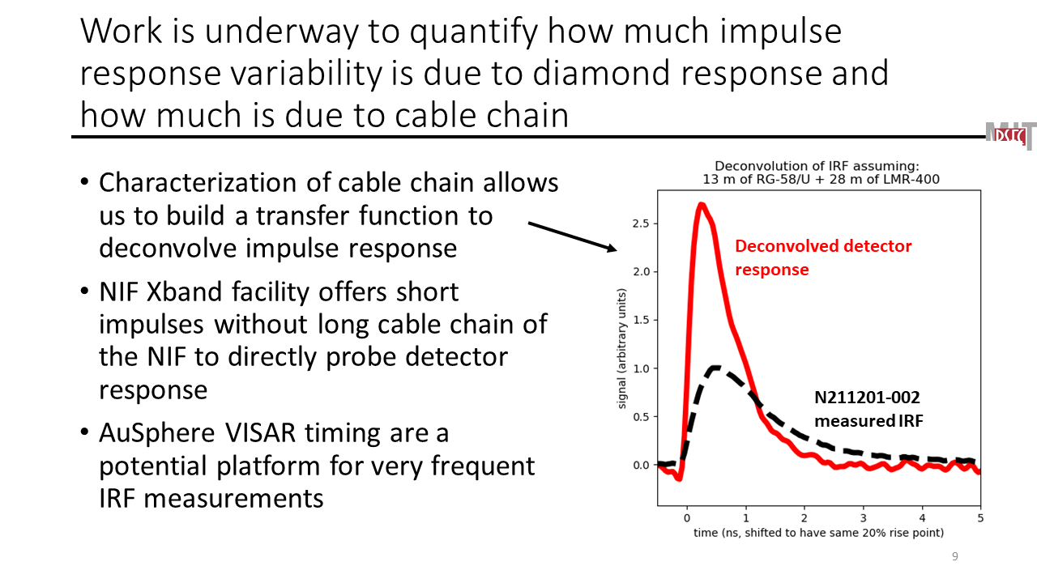
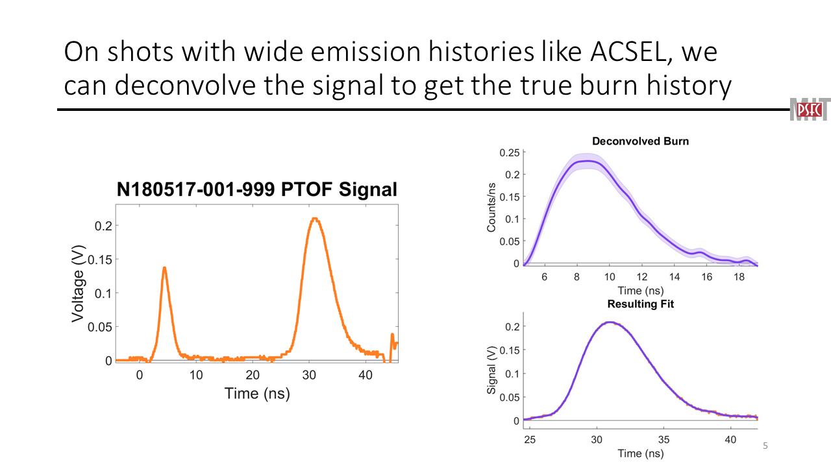
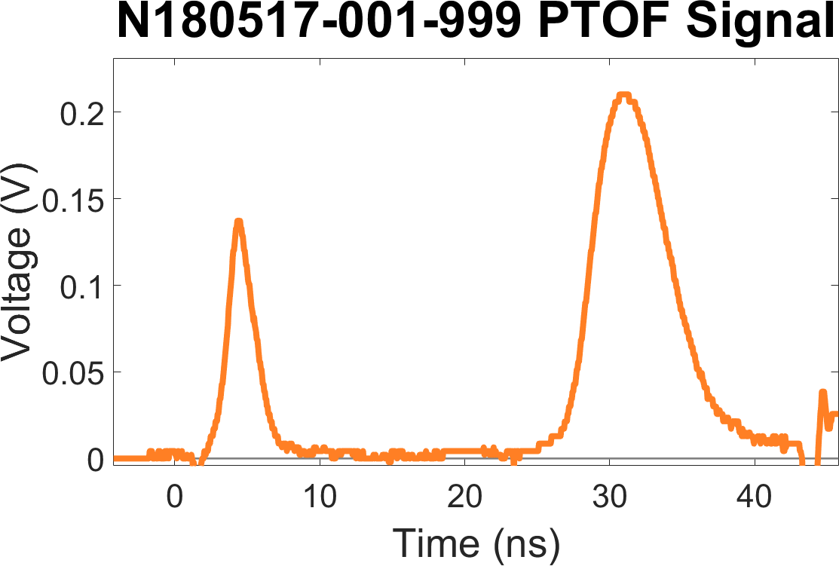
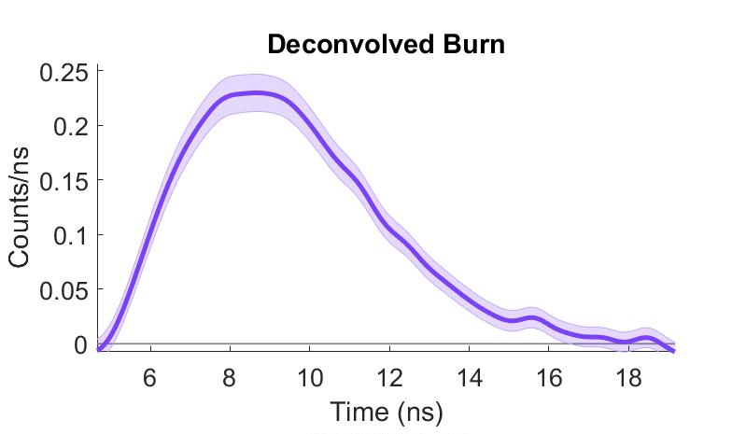
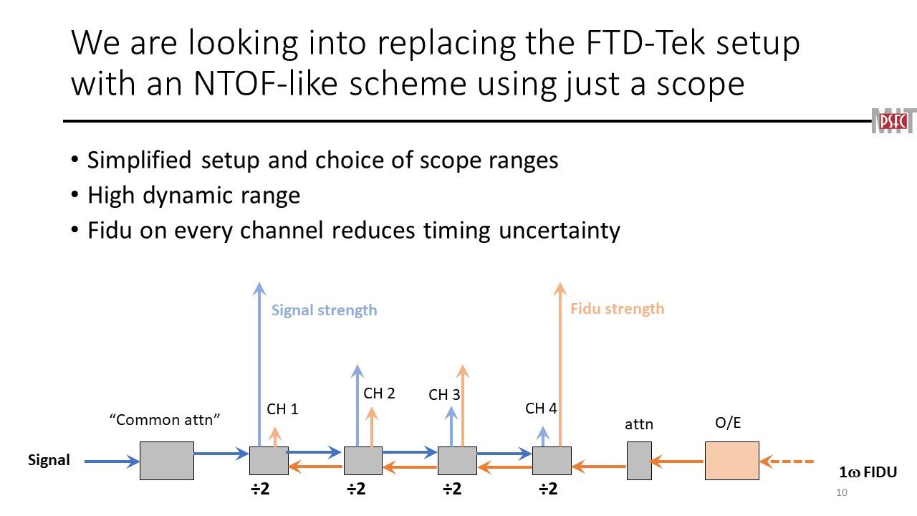


Particle time of flight (PTOF): A diagnostic for simultaneous measurements of multiple nuclear bang times at the NIF
B. Reichelt¹, N. Kabadi¹, M. Gatu Johnson¹, B. Lahmann¹, J. Frenje¹, C.K. Li¹, F. Seguin¹, G. Sutcliffe¹, R. Petrasso¹, H. Rinderknecht², J.R. Rygg², V. Glebov², J. Knauer², M. Rosenberg², C. Stoeckl², C. Sangster², C. Forrest²,
H. Sio³, A. Moore³, E. Mariscal³, J. Kimbrough³, F. Barbosa³, H.S. Park³, S. Friedrich³, M.J. Eckart³, E. Hartouni³, A. MacPhee³, A. Zylstra³, K. Baker³, D. Schlossberg³, J. Williams³, S. Kerr³, R. Leeper⁴, J. Kilkenny⁵
¹Massachussetts Institute of Technology, ²Laboratory for Laser Energetics, ³Lawrence Livermore National Laboratory, ⁴Los Alamos National Laboratory, ⁵General Atomics
PTOF can extract multiple nuclear bang time measurements from some shots
PTOF works with a principle similar to semiconductor radiation detectors– ionizing radiation incident upon a biased diamond frees electron hole pairs into the conduction band, where they are swept along by the bias and can be detected as an electric signal
Ionizing Protons, Neutrons, or Photons
X-rays
FTD10000
6 GHz Tek Scope
Freed electron-hole pair
Power supply applying bias voltage (-500V)
DD-n
The signal measured at the detector is a convolution of the burn history, time of flight variations from the energy spectrum, and detector + cable chain impulse response– by adjusting burn history parameters, a fit to experimental data is obtained
PTOF can extract multiple nuclear bang time measurements from some shots, which can be used to constrain $ρR$ evolution and give insight into other physical processes
Impulse Response
PTOF can determine burn histories if they are $≿1 ns$ although the width of the impulse response and time of flight broadening limits PTOF to only a bang time detector in most cases
Measured and forward fit PTOF signal
BT
LLNL-PRES-831505

