Slide 1
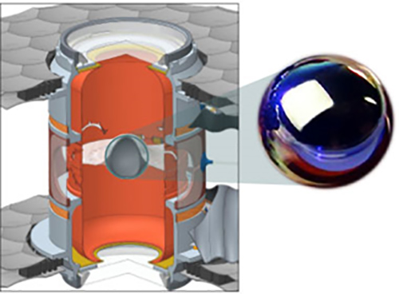
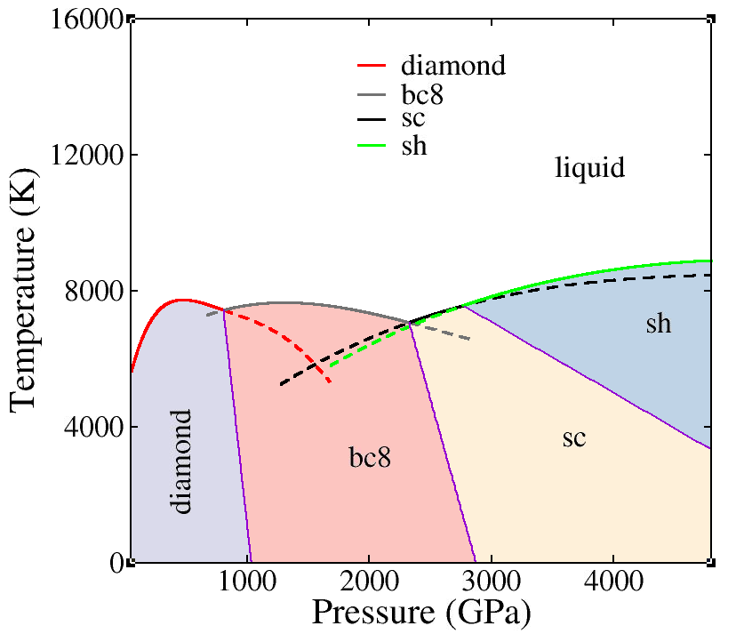
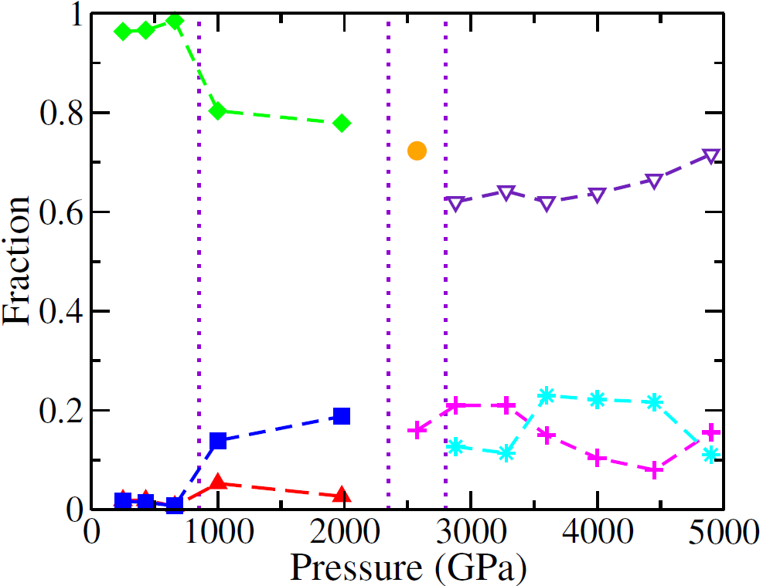
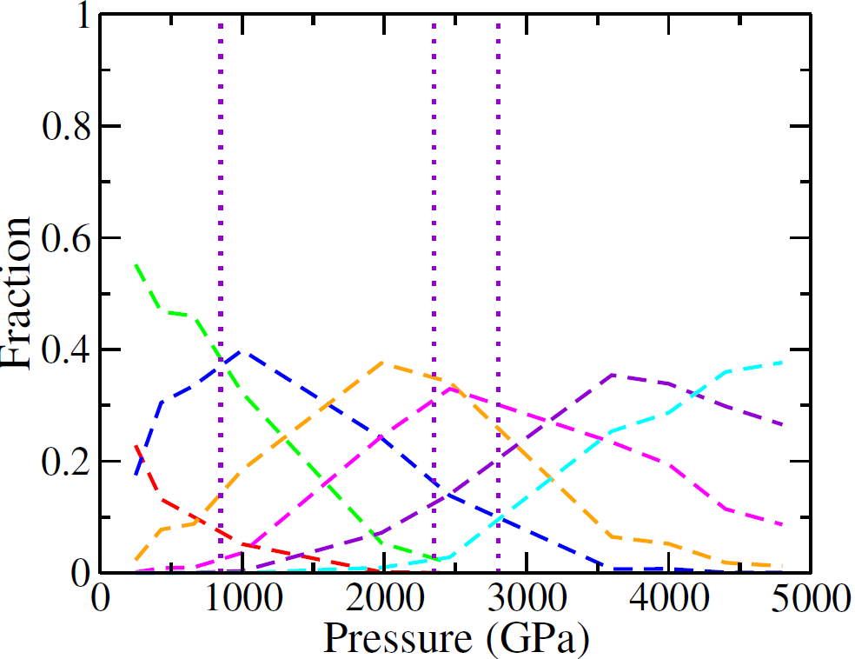
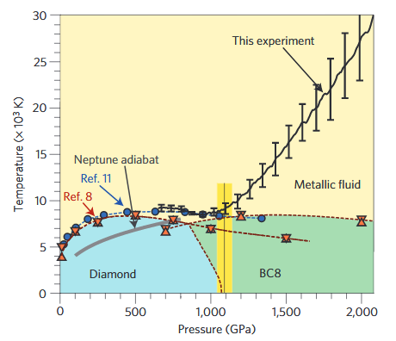
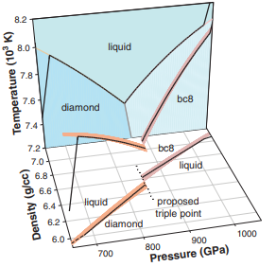
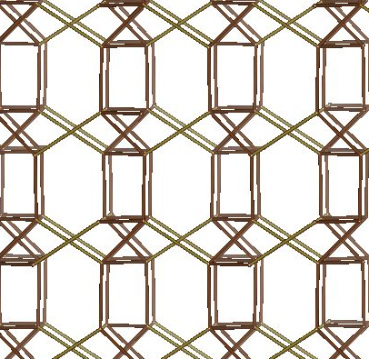
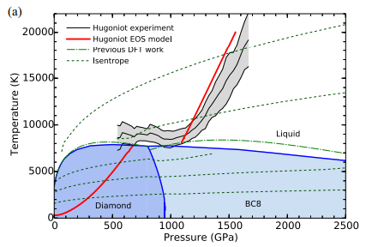
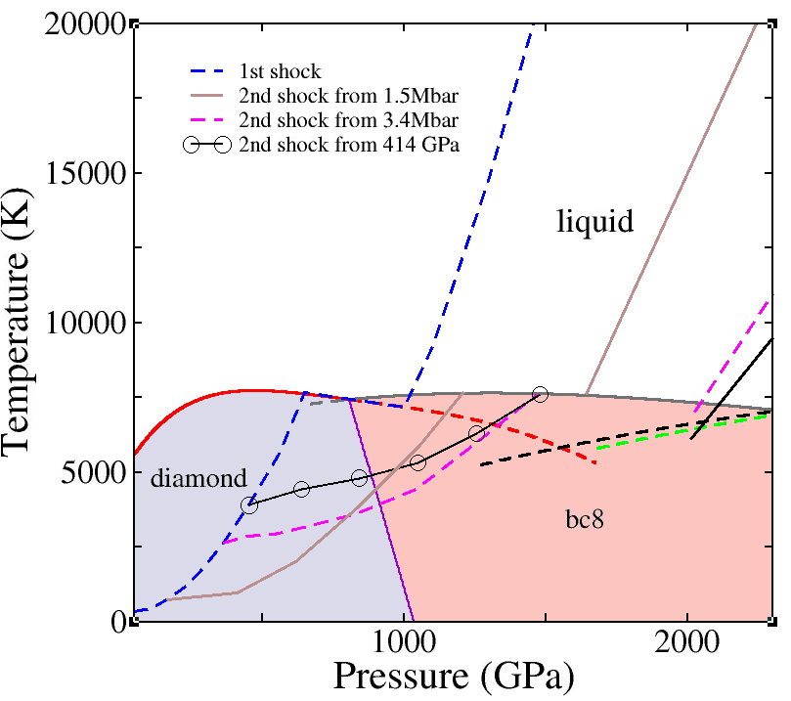
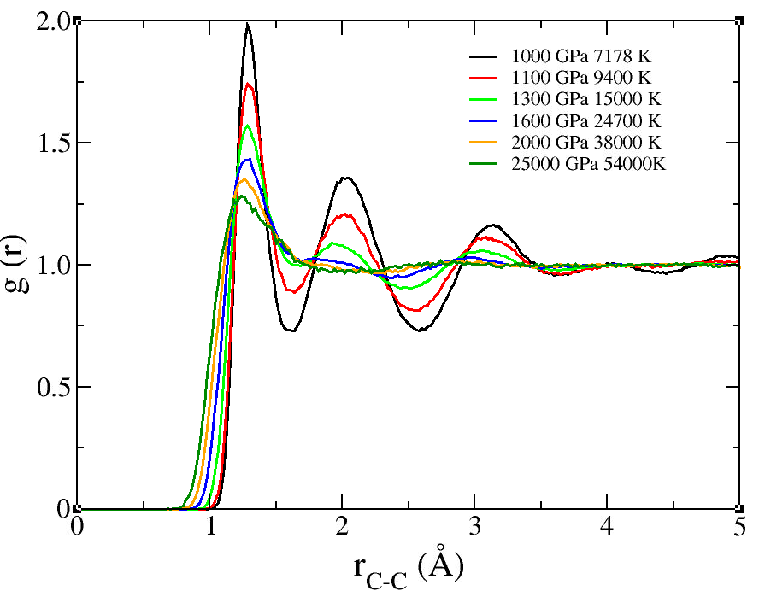
Carbon at Extreme Conditions
Kien Nguyen-Cong, Jonathan T. Willman, and Ivan I. Oleynik
Department of Physics, University of South Florida, USA
Anatoly Belonoshko
Department of physics, Royal Institute of Technology, Sweden
Prior research
Carbon at Extreme Conditions
Phase diagram
Liquid-solid along melting lines
High-PT behavior important for devising interior models of carbon-rich planets
Diamond is used as ablator material in ICF experiments: EOS is critical for designing experiments
Solid
Liquid
Image courtesy: LLNL
Eggert et al. Nature Phys 6, 40–43 (2010
Knudson et. al. Science 322 (5909), 1822-182
Benedict et al Phys Rev B 89, 224109 (2014)
Access various regions of phase diagram
by single and double shocks
Conclusions
Complex liquid behavior along the principal Hugoniot
Substantial uncertainties in both experimental and theoretical phase diagram
Obtained very accurate carbon phase diagram including melting lines of carbon phases up to 5 TPa
Characterized properties of liquid and solid along melting lines: complex liquid behavior at high-PT conditions
Proposed various shock compression pathways to access large P-T regions on carbon phase diagram
Goals
Obtain accurate high-P and high-T diamond, bc8 and sc melting lines up to 5 TPa using QM) simulations
Uncover properties of carbon under extreme conditions
Provide guidance for future dynamic experiments
Method
Acknowledgement
This work is supported by DOE/NNSA (grant # DE-NA0003910)
Computations performed using DOE leadership-class HPC system OLCF Summit provided via INCITE award (MAT198)
First-principles DFT qantun molecular dynamics (QMD) simulations
2-phase method in NPT ensemble to obtain melting line: 432 atom cells for diamond-liquid, 864 atom cells for bc-liquid and 1024 atom cell for sc-liquid and sh-liquid
NVT ensemble MD to construct equation of state (EOS) and hydrostatic Hugoniot: 216 atom cells for diamond, 432 atom cells for bc8.

