Slide 1
Utilizing directional secondary DT-neutron spectra to infer hot-spot performance of Inertial Confinement Fusion implosions
P.J. Adrian¹, B. Lahmann¹, A. Zylstra², E.P. Hartouni², M. Gatu Johnson¹, D. Casey², F. H. Seguin¹, C. K. Li¹, R. D. Petrasso¹ , J. Frenje¹
¹MIT NNSA Center of Excellence
²Lawrence Livermore National Laboratory
NIF Users Group Meeting 2020

Slide 2
Utilizing directional secondary DT-neutron spectra to infer hot-spot performance of Inertial Confinement Fusion implosions
Secondary DT measurements are used to infer hot spot areal density ($ρR$) at stagnation
Pressure degradation from low-mode asymmetries is quantified using inferred $ρR$
Measurements of directional secondary DT spectra are used to measure hot spot asymmetry

Slide 3
Secondary DT neutrons are observed on D₂ and D³He implosions
Imploded D-Filled
Capsule
Remaining
Ablator
Primary DD Reactions
Target
Fuel (DT)
Compressed
Deuterium Fuel
$$D+D→ \left\{\begin{matrix}{}_{}^{3}{He}\left(0.82 MeV\right) +n\left(2.45 MeV\right) \text{(50\%)} \\ T\left(1.01 MeV\right) +p \text{(3.02 }\text{MeV}\text{) (50\%)}\end{matrix}\right.$$
$$T\left(≤1.01 MeV\right) +D→ α+n\left(11.9 −17.2 MeV\right)$$
p
~150 um
$$T$$
$$α$$
Secondary DT-n Reaction
$$n$$
“Secondary DT Neutron”

Slide 4
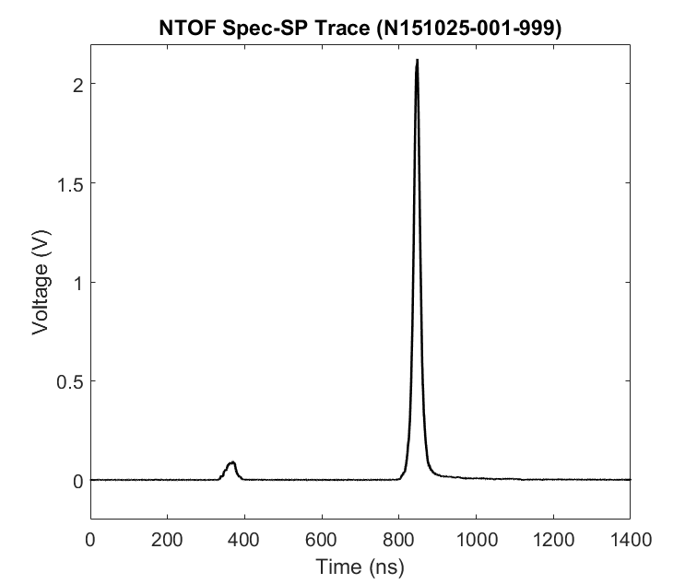
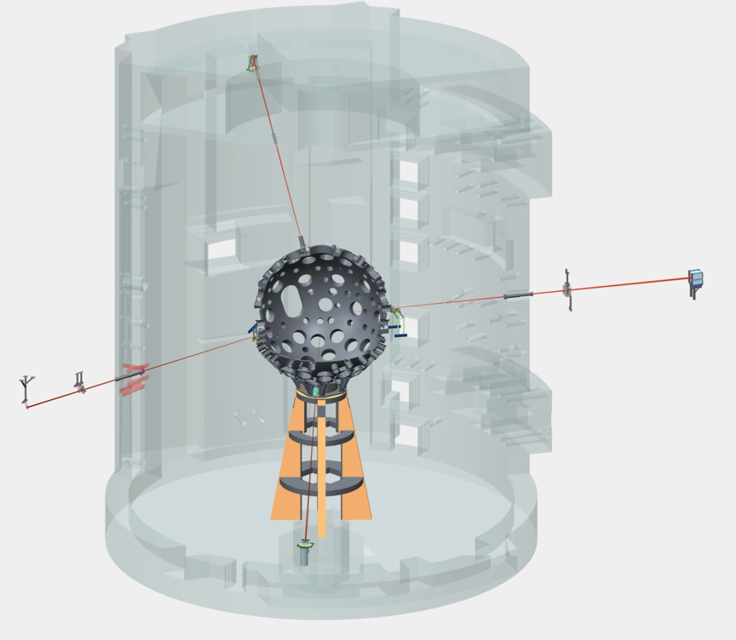
4 neutron time of flight (NTOF) spectrometers with different lines of sight are used
Neutron Time of Flight Trace (Shot N151025)
NIF Target Chamber
North Pole NTOF
(ϴ = 18°)
3.5$×10^{11}$ DD-n
Equator NTOF
(ϴ = 90°)
10m
Alcove NTOF
(ϴ = 116°)
$4.4×10^{9}$ DT-n
South Pole NTOF
(ϴ = 161°)

Slide 5
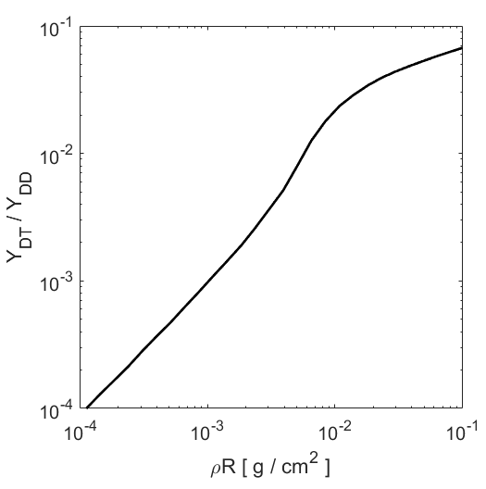
The yield ratio between primary and secondary neutrons
carries information about the hot-spot $ρR$
$$T_{e}=T_{i}=4 keV$$

Slide 6
Areal Density $(ρR)$ is inferred from secondary DT yields and used to evaluate performance of D³He surrogate implosions for
the HyE, Frust, HohlScan and HotThick campaigns
Key design changes are evaluated with measurements of $T_{DD}$ and $ρR$

Slide 7
Utilizing directional secondary DT-neutron spectra to infer hot-spot performance of Inertial Confinement Fusion implosions
Secondary DT measurements are used to infer hot spot areal density ($ρR$) at stagnation
Pressure degradation from low-mode asymmetries is quantified using inferred $ρR$
Measurements of directional secondary DT spectra are used to measure hot spot asymmetry

Slide 8
The final size of the hot spot (R_{final}) is inferred from
conservations of mass and the secondary yield
Capsule before shot
Capsule at peak convergence
Conservation of Mass
$$ρ_{initial}R_{initial}^{3}=ρ_{final} R_{final}^{3}$$
$$R_{i}^{initial}$$
$$t^{initial}$$
$$R_{i}^{final}$$
$$t^{final}$$
$$R_{final}=\sqrt{\frac{ρ_{initial}R_{initial}^{3}}{ρ_{final} R_{final}}}$$
Known
Inferred

Slide 9
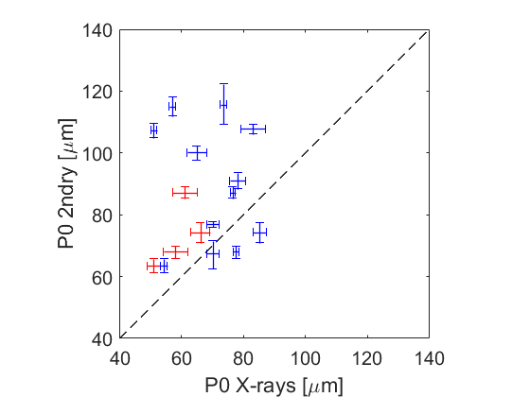
The P0 (R_{final}) inferred from the secondary data is poorly correlated
with the measured P0 from x-ray imaging
X-rays

Slide 10
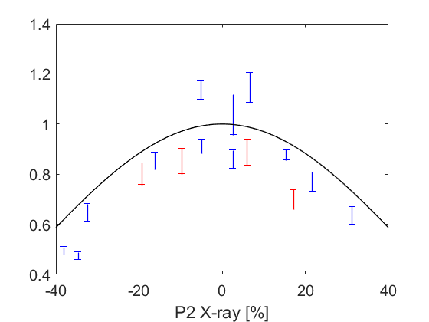
The difference between P0 measured from secondaries and x-rays is highly correlated with the P2 of the x-ray image suggesting the data set is sensitive to low mode asymmetry
$$\frac{P0 Xrays}{P0 2ndry}$$
$$∝1 −(P{2)}^{2}$$
P2 X-rays [%]

Slide 11
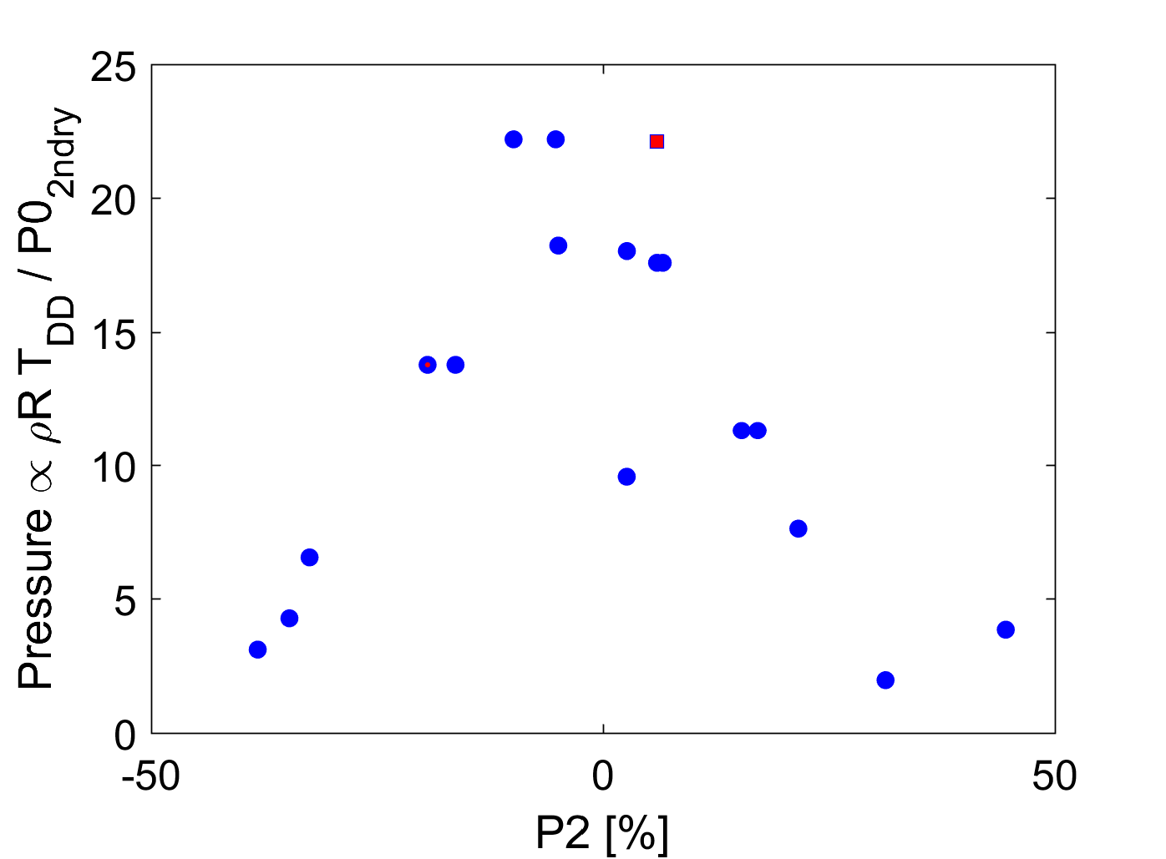
Inferred hot spot pressure is also observed to be highly correlated with the P2 observed by x-ray imaging
$$Pressure [Gbar]$$
$$Pressure∝ ρ_{final} × T_{DD}$$
Secondaries
Primaries

Slide 12
A piston model for mode-2 asymmetry predicts pressure degradation scales as (1- P2)², as observed in the data
Varying coast time
Piston model predicts pressure degradation has small sensitivity to coast time
Suggests secondary data can be used to quantify how much pressure degradation is attributed to low-mode asymmetry

Slide 13
Utilizing directional secondary DT-neutron spectra to infer hot-spot performance of Inertial Confinement Fusion implosions
Secondary DT measurements are used to infer hot spot areal density ($ρR$) at stagnation
Pressure degradation from low-mode asymmetries is quantified using inferred $ρR$
Measurements of directional secondary DT spectra are used to measure hot spot asymmetry

Slide 14
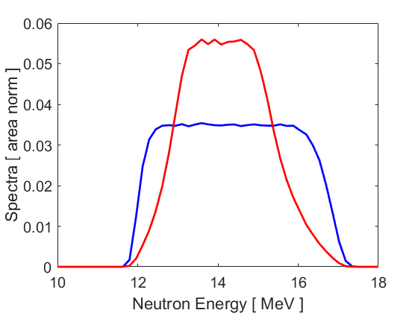
The shape of the secondary neutron spectra is a function of the hot-spot $ρR$
$$ρR=180 mg/cm^{2}$$
$$20 mg/cm^{2}$$

Slide 15
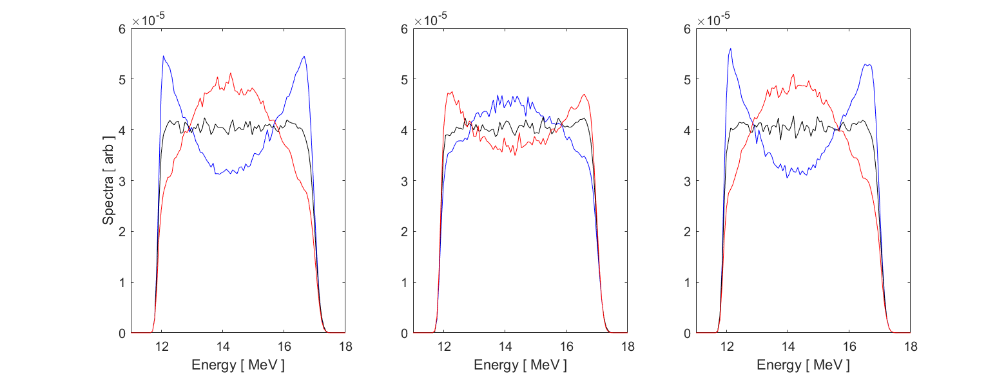
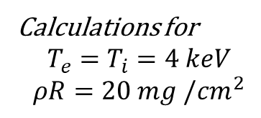
Hot-spot $ρR$ asymmetries impact the shape of the secondary neutron spectra measured along different lines of sight
P$2$/P0 = {+40%, 0%, -40%}
North Pole
Equator
South Pole
Calculations for
$$T_{e}=T_{i}=4 keV$$
$$ρR=20 mg /cm^{2}$$

Slide 16
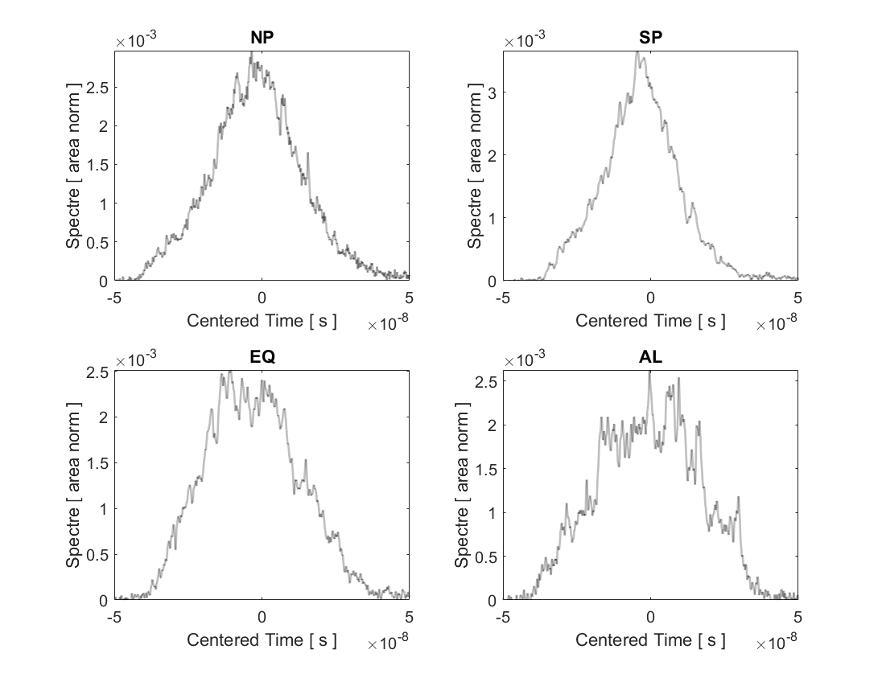
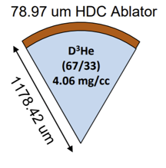
nTOF traces observed in different directions show asymmetries
N190218 (I_Int_Sym_HyE_S01a)
Notice both the primary difference is in the width of the polar versus equatorial traces

Slide 17
The observed spectra at the poles and equator for N190218
can be explained by a large P2 and Carbon mix
P0 = 100 um
P2 = 0 %
No Mix
P0 = 90 um
P2 = -60 %
No Mix
P0 = 95 um
P2 = -60 %
20 $μg$ Carbon mix

Slide 18
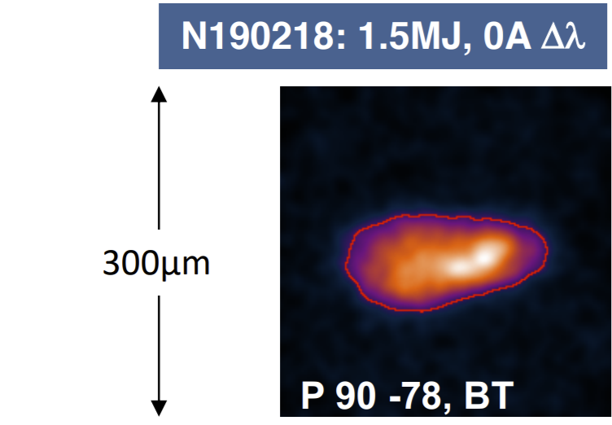
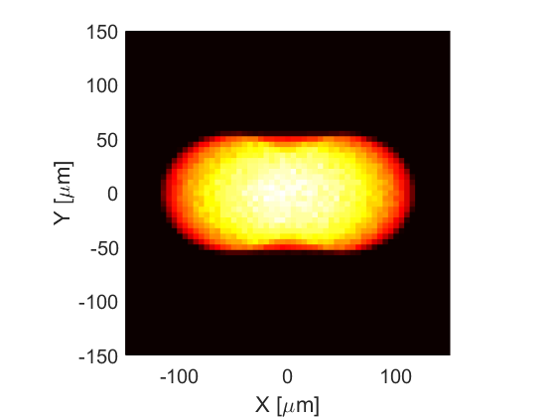
X-ray images calculated from the fuel geometry inferred from the secondaries compare favorably with measured x-ray images
Synthetic X-ray image from fuel shape and composition inferred from DT secondaries
Shape | Equator X-ray Image | Synthetic Equatorial X-ray image
P0 [um] | 72.4 | 74
P2 [ um ] | 30.4 | 25

